Slide 1
LESSON 4
The Role of Red Meat in a Healthy
Balanced Diet

Slide 2
Learning Intentions
By the end of this presentation, we will learn about:
Current food trends and how they can affect our health
The nutrients found in red meat and why they are important
What counts as a portion of red meat
How different foods can work together to help our bodies absorb nutrients

Slide 3
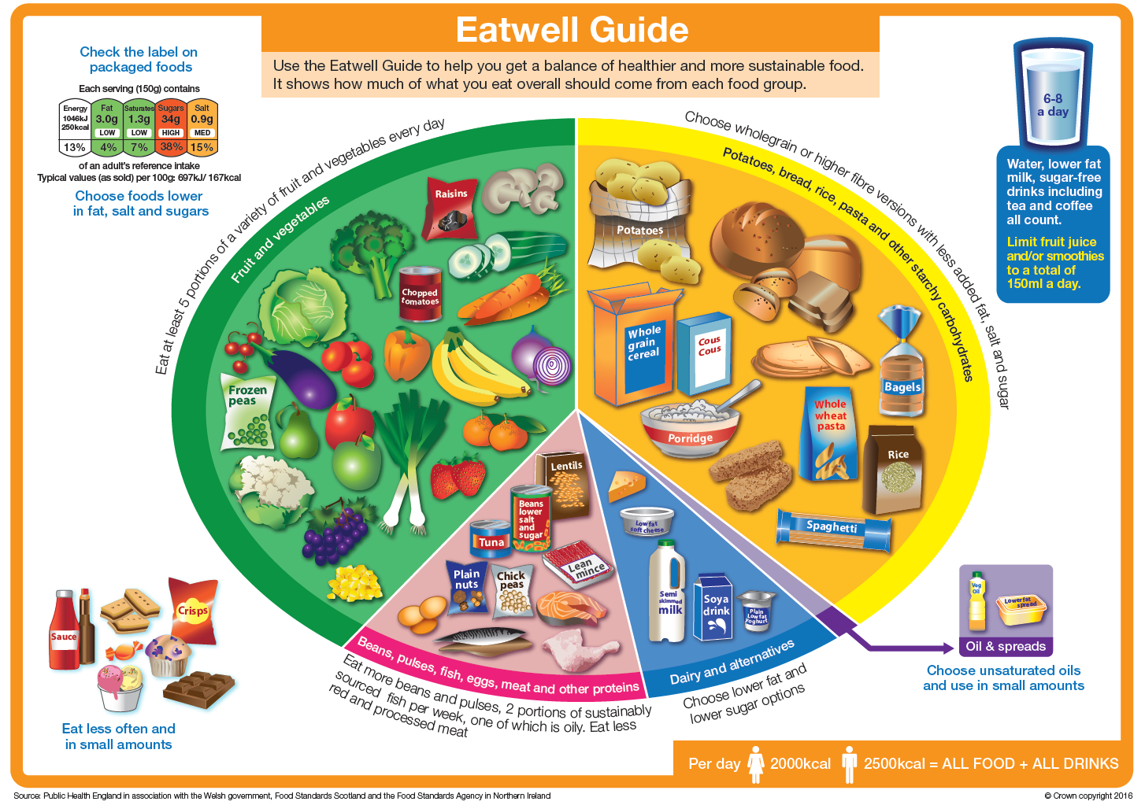
Eatwell Guide
5 main food groups
Variety is important - eat a range of different foods
No single food group needs to be completely avoided
Red meat can be included as part of a healthy, balanced diet.
Food Standards Scotland Interactive Eatwell Guide

Slide 4
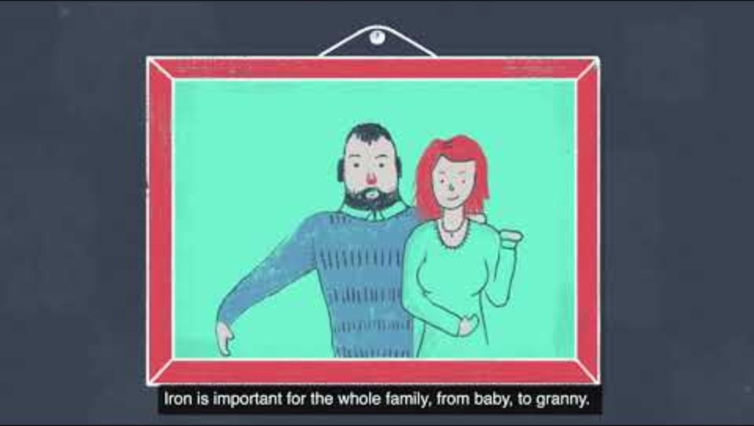
The Meat we Eat video
I see, I think, I wonder…
After watching the video, discuss:
How is meat often shown in the media?
Can meat be part of a healthy, balanced diet?
How much meat is recommended?
What nutrients are found in meat?
Notes:
Making Thinking Visible

Slide 5
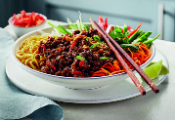
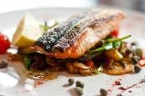
Flexitarianism and Plant based diets
72.4% of consumers regularly eat meat, fish and poultry. (2026, Worldpanel by Numerator)
23.4% identify as flexitarian – reducing the amount of meat they eat.
5.9% are vegetarian.
1% are vegan – avoiding all animal products.
A plant-based diet does not always mean avoiding meat.
A flexitarian diet includes some meat and other plant-based foods.
“Eat less, but eat better” – what could this mean?
Discuss quality vs quantity.

Slide 6
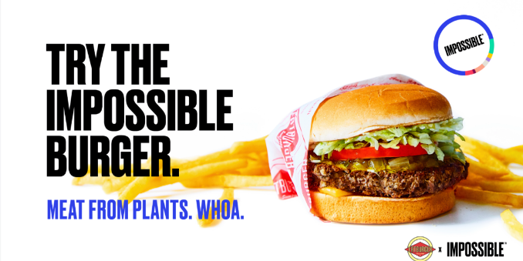
Is plant based all that meets the eye? Consider the Impossible Burger
It contains soy-based leghemoglobin, a protein which helps give it a red, meat-like colour.
Leghemoglobin contains haem, which is responsible for the colour.
It is also made using yeast fermentation.

Slide 7
Compare the ingredients list
Impossible burger | Homemade Scotch Beef burger
Water Soy Protein Concentrate Coconut Oil Sunflower Oil Natural Flavours Potato Protein Methylcellulose Yeast Extract Cultured Dextrose Food Starch Modified Soy Leghemoglobin Salt Mixed Tocopherols (Antioxidant) Soy Protein Isolate Zinc Gluconate Thiamine Hydrochloride (Vitamin B1) Niacin (Vitamin B3) Pyridoxine Hydrochloride (Vitamin B6) Riboflavin (Vitamin B2) Vitamin B12 The Impossible Burger contains an allium derivative. Alliums are the family of plants that includes garlic, onion, shallots, and others. | Scotch Beef Salt Pepper Optional ingredients to help bind together different flavourings Breadcrumbs Egg Spices Herbs Garlic Onion Vegetables
Look at the ingredients in each burger.
What do you notice about the number of ingredients in each burger?
Are there any ingredients you don't recognise?
What other food trends are popular right now?
Which trends do you think might stay popular?

Slide 8
Think, Pair, Share…
Why not try adding more fruit or vegetables to your own burgers to help towards your 5 a day?
Some ideas:
Pork and Apple
Lamb with mint and garlic
Beef and Roasted pepper
Create your own burger flavour combination.
Think – Choose beef, lamb or pork and create a new flavour combination using fruit, vegetables, herbs or spices.
Pair – Share your idea with a partner. What ingredients have you chosen and why?
Share – Present your burger idea to the class.
Challenge: Can you explain how your ingredients could add flavour and nutrients to your burger?

Slide 9
What nutrients does red meat provide?
IRON
Helps develop healthy red blood cells, transporting oxygen around the body; reduces tiredness.
PROTEIN
Growth, repair and maintenance of all body tissues.
VITAMIN B
Helps release energy from food.
The Mineral - ZINC
Supports a healthy immune system and helps with normal growth and development.
The Mineral - POTASSIUM
Supports normal blood pressure; contributes to muscle function.
Did you know?
Farming and butchery techniques have significantly lowered the fat content of meat.
Red meat is naturally low in salt

Slide 10
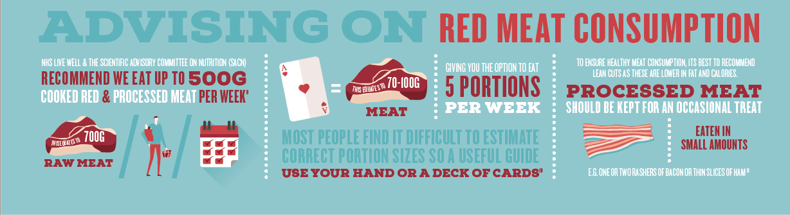
What is a portion?
The Scottish Dietary Goal is around 70g of red and processed meat per person per day, on average. This is about 500g per week. For example:
2 slices of roast meat - 70g
2 sausages - 70g

Slide 11
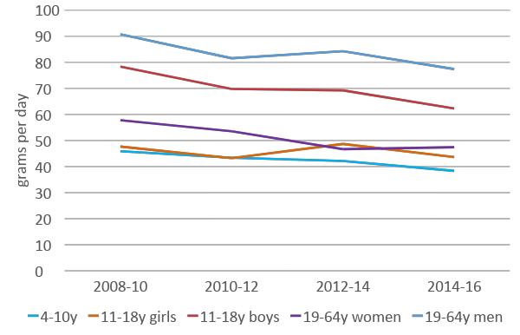
Red meat consumption is changing
Scottish dietary goal - 70g/day
Women are eating 19% less red meat
Men are eating 15% less. (NDNS)
Average Scottish intake of red and red processed meat 48.7g per day (Scottish Health Survey, 2021)

Slide 12
Red meat is a source of important nutrients, including iron and zinc.
Reduction in red meat intake has the potential for nutrient deficiencies.
What is a deficiency?
If we reduce the amount of red meat we eat, we need to make sure we get these nutrients from other foods.
When your body does not get enough of a particular nutrient to meet its needs.
For example, not getting enough iron can lead to iron deficiency anaemia. Iron is needed to make red blood cells (haemoglobin), which carries oxygen around the body. Leaving you feeling tired if you don’t get enough.
27% of women and 42% of teenage girls do not achieve the minimum recommended iron intake.
Around 1 in 10 teenage girls have low haemoglobin levels. 22% have low ferritin levels.
22% teenage girls don’t get enough zinc.

Slide 13
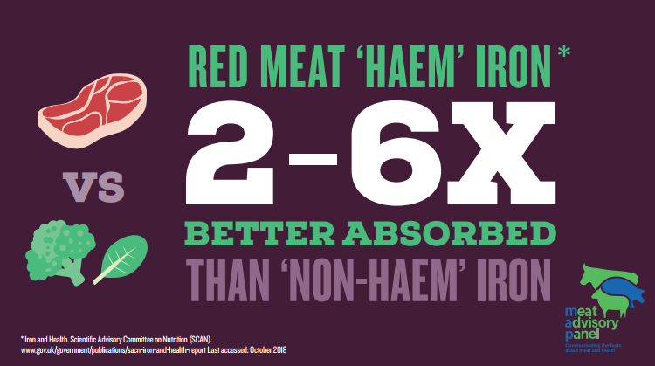
Iron Absorption
Haem iron - Found in red meat and is more easily absorbed by the body.
Non-haem iron - Found in plant foods such as beans, nuts, dried fruit and pulses like lentils. Vitamin C helps the body absorb non-haem iron.
Think, Pair, Share - How could you combine red meat with foods high in vitamin C?
For example:
Scotch Beef fajitas with beans & peppers
Can you create your own combination?

Slide 14
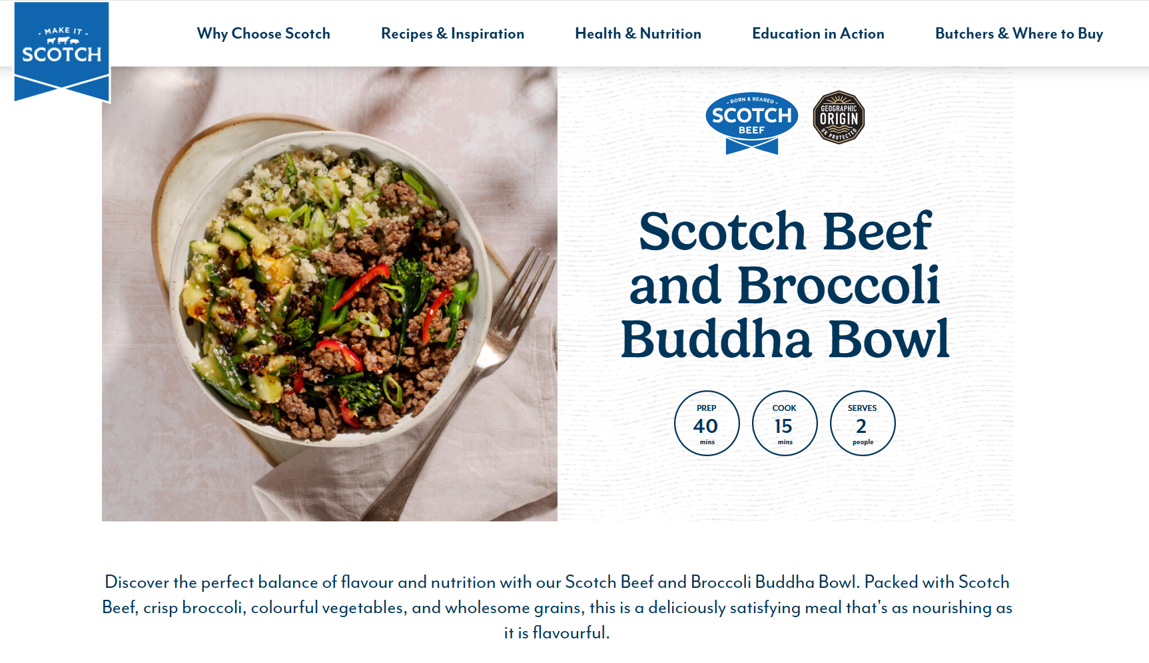
This recipe is particularly good as it is high in Vitamin C, a great source of Fibre and contributes 43% of your Recommended Daily Intake (RDI) for Iron!
Click here to take you to the recipe

Slide 15
Test your knowledge quiz
It’s time to put learning to the test with our simple quiz.
It will cover the content of this lesson, the main learning takeaways and provide opportunities for class discussion.

Slide 16
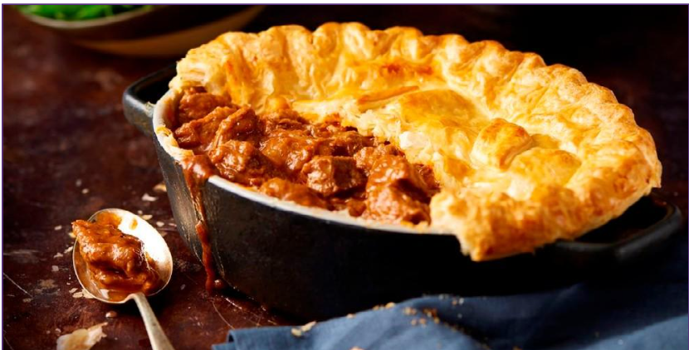
NHS Live Well advises that we can eat up to how much cooked and processed meat per week?
A - 300g
B - 500g
C - 700g
D - 900g

Slide 17
NHS Live Well advises that we can eat up to how much cooked and processed meat per week?
A - 300g
B - 500g
C - 700g
D - 900g

Slide 18
Which of the main food groups (Eatwell Guide) does red meat sit in?
A - Fruit & Vegetables
B - Starchy Carbohydrates
C - Dairy
D - Protein

Slide 19
Which of the main food groups (Eatwell Guide) does red meat sit in?
A - Fruit & Vegetables
B - Starchy Carbohydrates
C - Dairy
D - Protein

Slide 20

The absorption of Haem iron (found in red meat) is improved when combined with food containing which vitamin?
A - Vitamin A
B - Vitamin B
C - Vitamin C
D - Vitamin D

Slide 21
The absorption of Haem iron (found in beef) is improved when combined with food containing which vitamin?
A - Vitamin A
B - Vitamin B
C - Vitamin C
D - Vitamin D

Slide 22

A lack of iron (a deficiency) can cause which of the following symptoms? (select all that apply)
A - Tiredness (fatigue)
B - Pale skin
C - Dizziness
D - Weakness

Slide 23
A lack of iron (a deficiency) can cause which of the following symptoms? (select all that apply)
A - Tiredness (fatigue)
B - Pale skin
C - Dizziness
D - Weakness

Slide 24
Task
Complete the worksheet to test your knowledge and understanding of the role of red meat within a healthy, balanced diet.

Slide 25
Success Criteria
I can:
Identify different food trends and give an example of how a food trend could affect health.
Match key nutrients found in red meat to their functions in the body.
Identify the correct portion size of red meat
Describe the difference between haem and non-haem iron.
Identify foods high in vitamin C that could be eaten alongside iron-rich foods to help the body absorb iron.

