Slide 1
LESSON 5
Preparing and Cooking Red Meat

Slide 2
Learning Intentions
By the end of this presentation, we will:
Understand the characteristics of red meat.
Identify different cuts of meat.
Learn about food preparation techniques for meat.
Understand different cookery processes.
Understand the benefits of supporting local producers.
Understand the importance of reducing food waste and using leftovers.

Slide 3
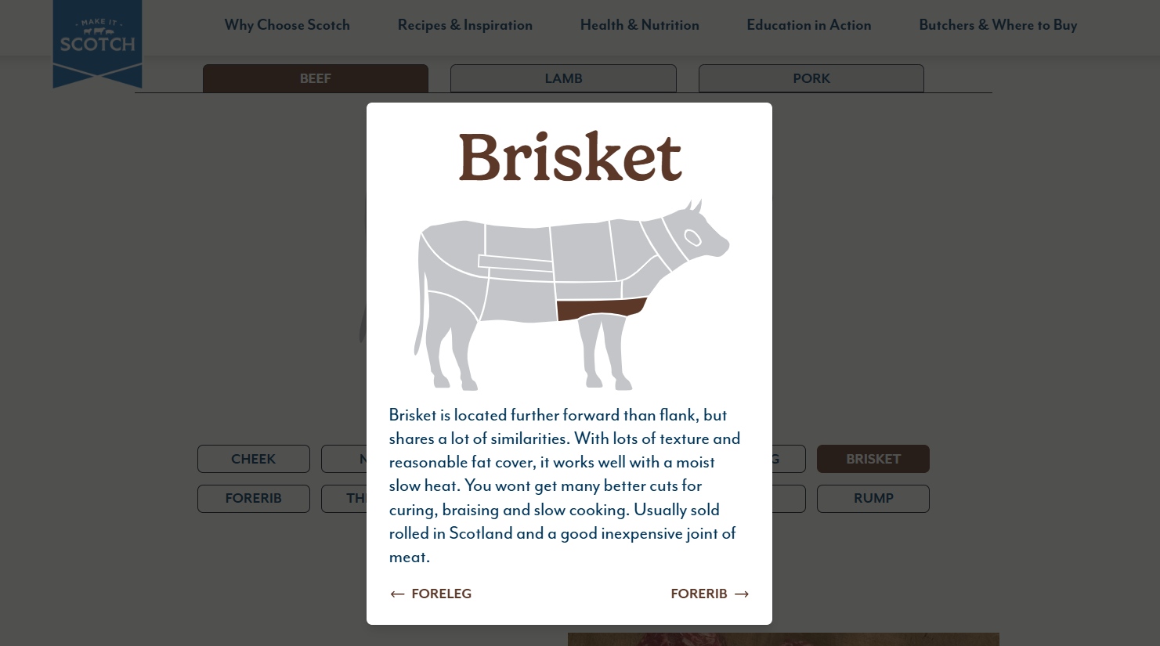
Explore the different cuts of beef, lamb and pork at makeitscotch.com
Click here to take you to makeitscotch.com

Slide 4
Meat Characteristics
Muscle & Connective Tissue (protein)
Different cuts of meat have different characteristics.
Tender cuts can be cooked quickly and at a high heat, e.g. beef fillet & sirloin steak
Tougher cuts contain more connective tissue and benefit from slow, moist cooking to soften the collagen (connective tissue) to make the meat more tender e.g. beef brisket, lamb shoulder, pork hock.
Fat
Water

Slide 5
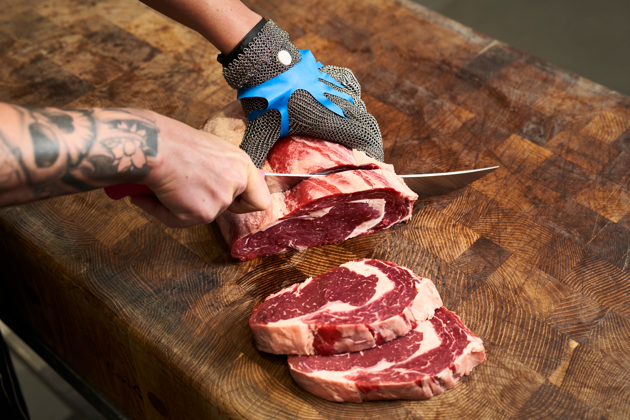
Meat Characteristics - Marbling
Marbling is the small streaks of fat found within the muscle.
Marbling can add flavour and juiciness when meat is cooked.
The amount of marbling varies between animals and cuts.
Ribeye is an example of a well-marbled cut, shown in the image.

Slide 6
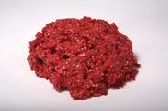
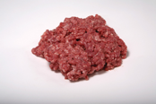
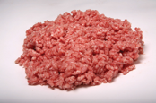
Meat Characteristics - Colour
The red colour is due to the protein called myoglobin and some haemoglobin.
Different meats contain different amounts of myoglobin, giving them different shades of red.
What else could affect meat colour?
Animal age – older animals can have darker meat.
Muscle/activity – muscles that are used more can contain more myoglobin.
Oxygen – exposure to oxygen can change the colour.
Storage and packaging – oxygen levels and packaging can affect how the meat appears.
Diet and breed can also influence meat colour
Beef
Lamb
Pork
Look at the mince images – which is beef, lamb and pork?

Slide 7
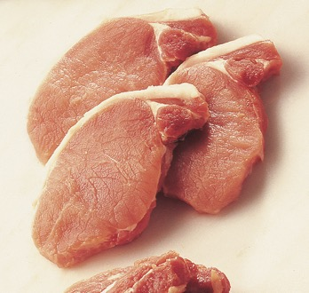
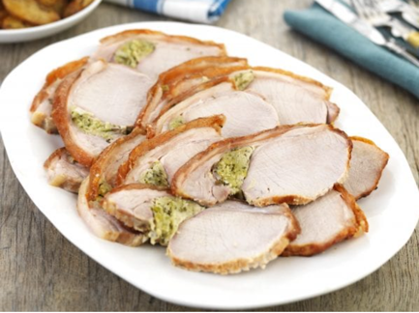
Pork is still classed as red meat
Even though it is the palest

Slide 8
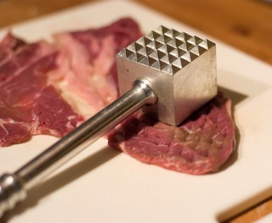
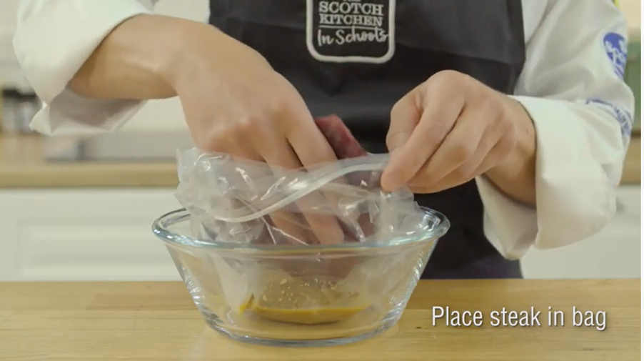
Food Preparation Techniques
Tenderising helps make tougher meat more tender before cooking.
Mincing breaks meat into small pieces and can be used for tougher cuts such as neck and shoulder.
Beating with a meat mallet helps break down muscle fibres.
Marinating can add flavour and change the texture of meat. Acidic ingredients, such as lemon juice or vinegar, can affect the proteins on the surface.
Watch the recipe video: What colour change can you see after marinating?

Slide 9
Cookery Processes

Slide 10
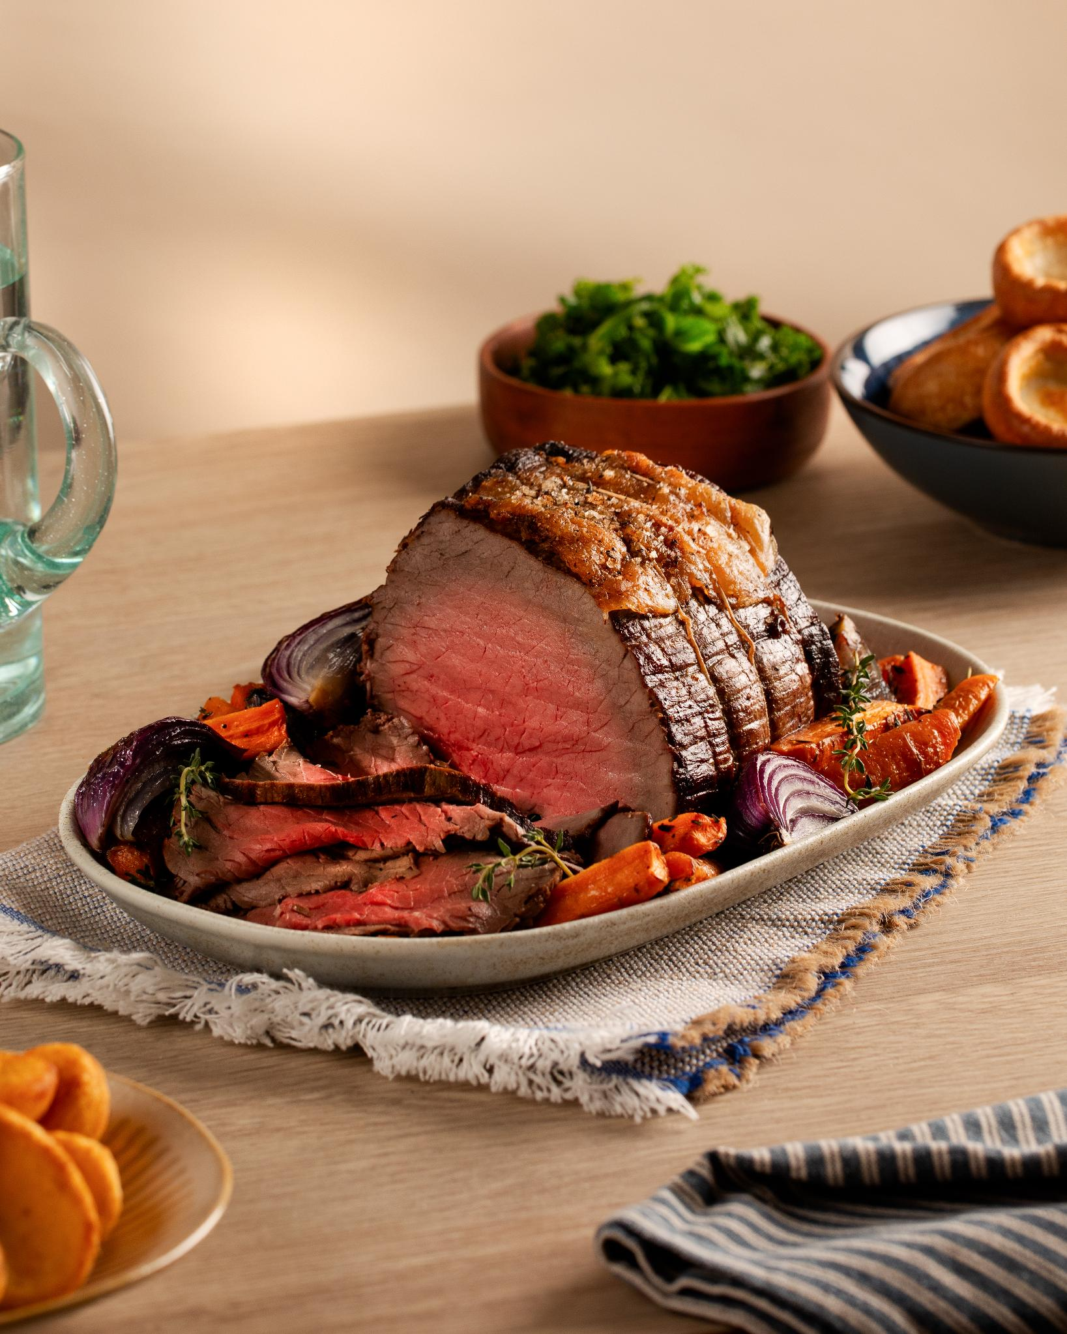
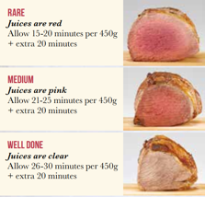
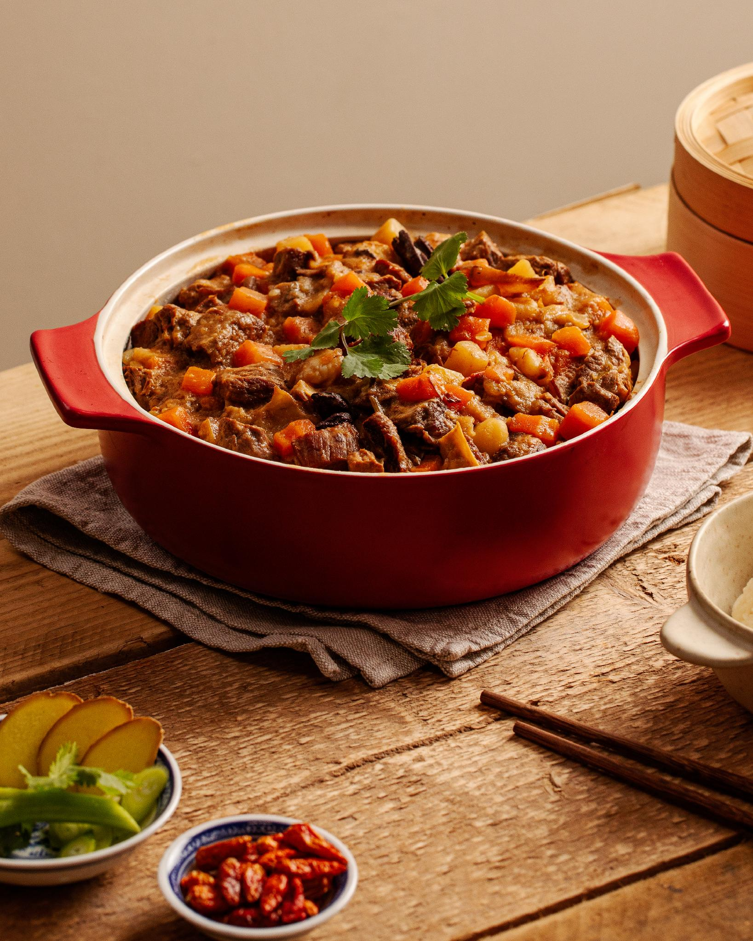
Roasting
Stewing
Cooking food using dry heat, usually in an oven.
Often used for larger cuts or joints of meat
The high heat creates browning and caramelisation, which can add flavour
The Maillard reaction also contributes to browning and flavour.
Cooking small pieces of meat slowly in liquid, usually at a gentle simmer.
Meat is covered with liquid, such as stock.
Vegetables can be added for flavour.
Meat can be browned first to add colour and flavour.
Suitable for tougher cuts, as slow cooking helps make them tender.

Slide 11
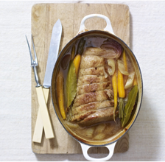
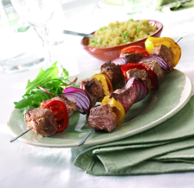
Grilling & Barbecuing
Slow cooking / Pot Roasting
Grilling cooks meat using direct, high heat, usually from above.
A quick cooking method
Suitable for tender cuts, such as steaks and chops
Produces browning and adds flavour
Barbecuing cooks meat over a heat source, using direct or indirect heat.
Can be cooked more slowly at a lower temperature
Can add a smoky flavour
Suitable for a range of meat cuts
Slow cooking uses low heat over a longer period of time, often with liquid.
Suitable for tougher cuts such as shin, brisket and chuck.
Can be done in a slow cooker, oven or on the hob.
Pot roasting cooks a larger piece of meat slowly in a covered dish with a small amount of liquid.
Slow cooking helps make meat tender.

Slide 12
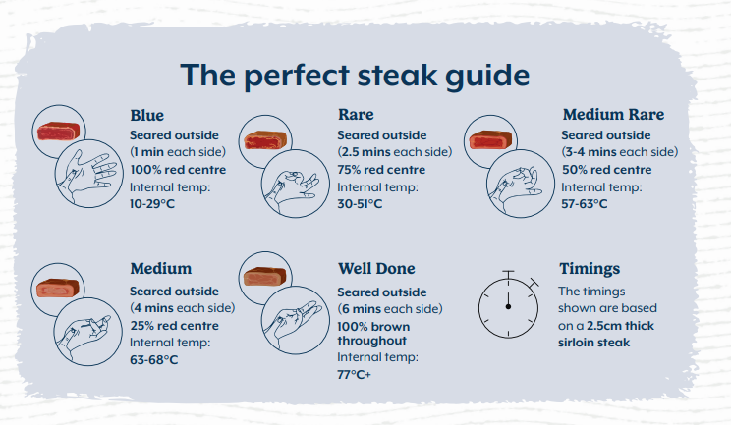
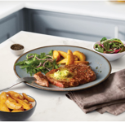
Frying
How would you like yours?
Cooks meat using oil or fat in a pan.
High heat helps brown the surface and develop flavour.
A small amount of oil can be used for pan frying.
Stir-frying uses small pieces of meat and vegetables, usually cooked quickly in a wok or wide pan.
Suitable for tender cuts and smaller pieces of meat.
Think: Why is it important to get the pan hot before frying meat?

Slide 13
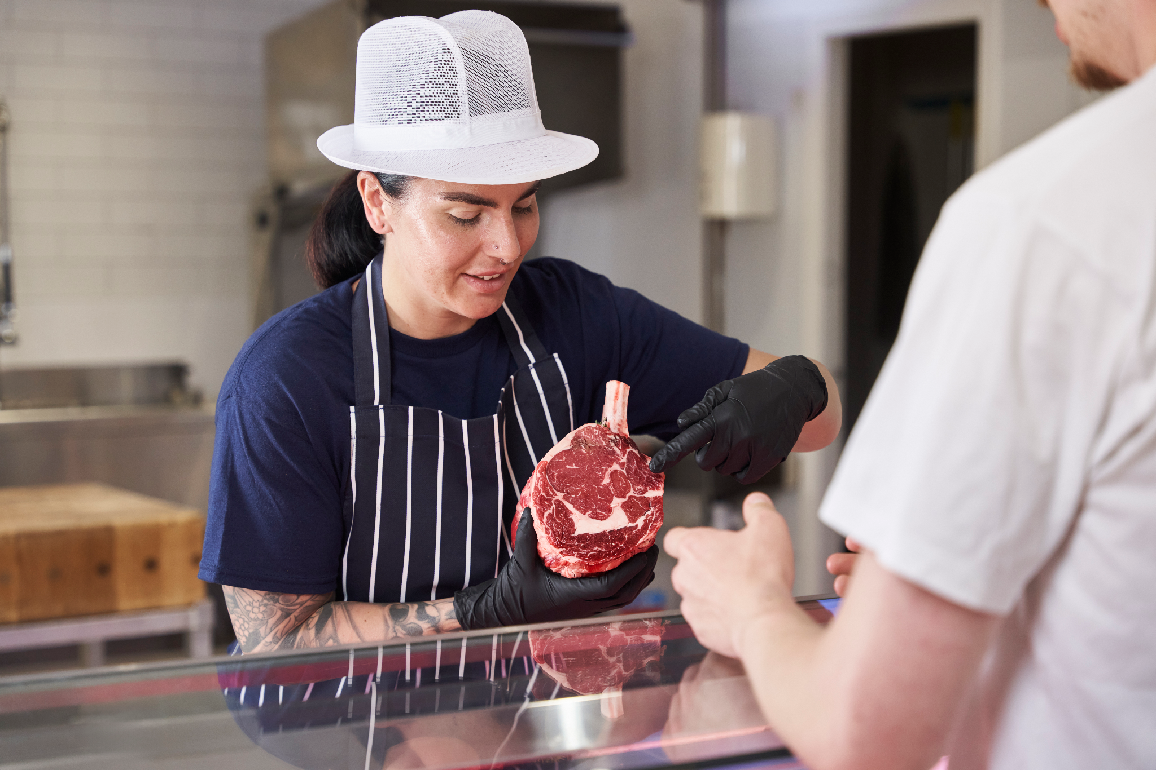
Supporting Local - The Butcher
Using a local butcher can offer several benefits:
Food miles - buying locally sourced Scotch meat can reduce the distance food travels.
Support local producers and businesses.
Know where it comes from - some butchers can tell you the farm or source.
Expert advice on cuts, preparation and cooking.
Choose your portion size - buy the amount you need.
How can buying local affect the food miles of your meat?

Slide 14
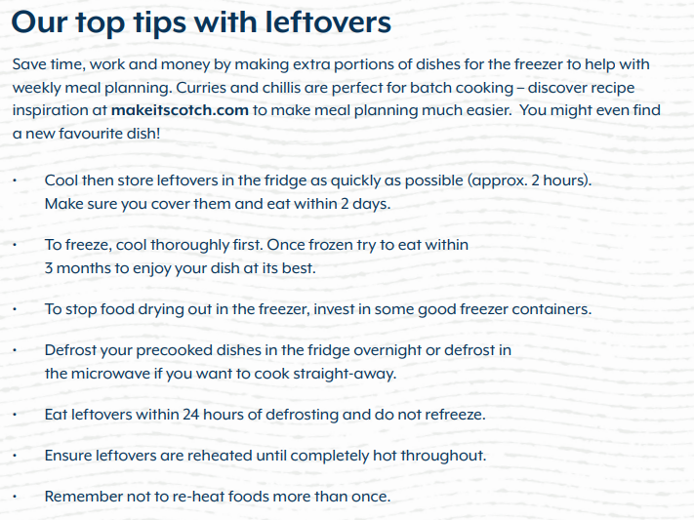
Food Waste
Food loss & waste has a major environmental impact.
If food loss and waste were a country, it would be the world's third-largest greenhouse gas emitter.Food and Agriculture Organization (FAO) of the United Nations.
This is because greenhouse gases are produced when food is grown, processed, transported, stored and disposed of - even when the food is never eaten!
What can we do to reduce food waste when buying, cooking and eating meat?
For further advice on storing and reheating food visit Food Standards Scotland

Slide 15
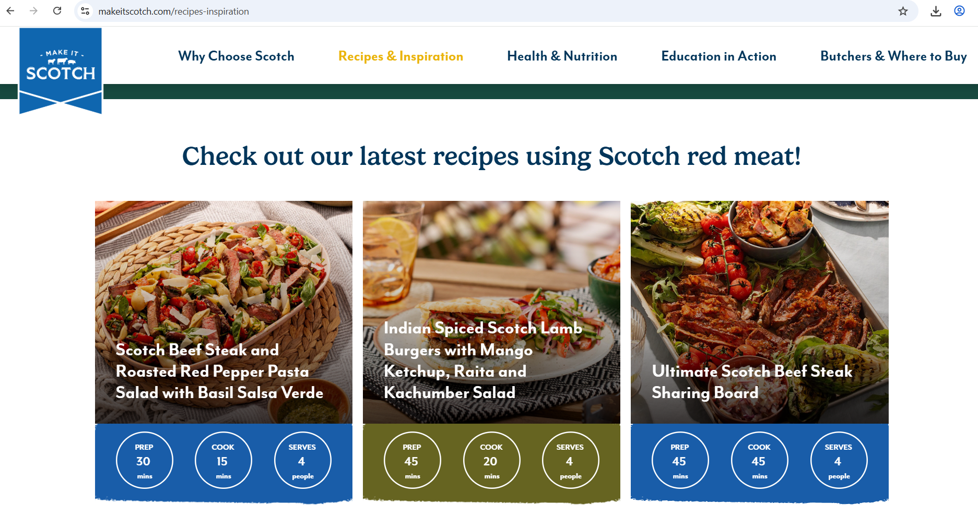
Looking for recipe inspiration?
Visit makeitscotch.com

Slide 16
Test your knowledge quiz
It’s time to put learning to the test with our simple quiz.
It will cover the content of this lesson, the main learning takeaways and provide opportunities for class discussion.

Slide 17
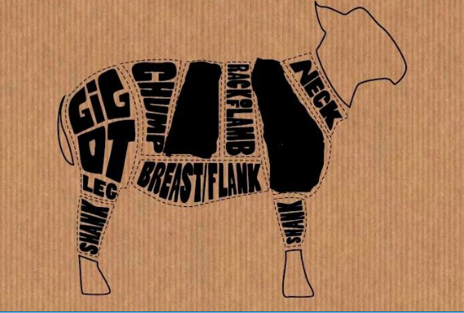
Which two cuts of lamb have been blanked out?
A - Sirloin
B - Loin
C - Shoulder
D - Braising steak

Slide 18
Which two cuts of lamb have been blanked out?
A - Sirloin
B - Loin
C - Shoulder
D - Braising steak

Slide 19
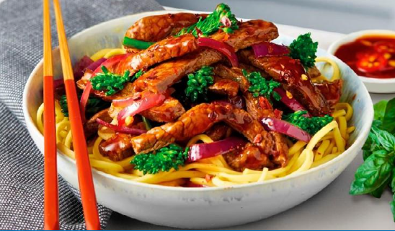
Which cooking methods can be healthier ways to prepare red meat? Select all that apply.
A - Deep fat frying
B - Grilling
C - Baking
D - Shallow frying

Slide 20
Which cooking methods can be healthier ways to prepare red meat? Select all that apply.
A - Deep fat frying
B - Grilling
C - Baking
D - Shallow frying

Slide 21
Different cuts of meat are better suited to different recipes and cooking methods.
True
Or
False

Slide 22
Different cuts of meat are better suited to different recipes and cooking methods.
True
Or
False

Slide 23
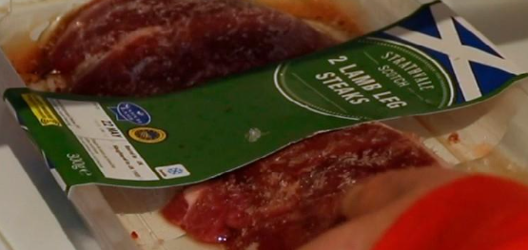
Where in your fridge should raw meat be stored?
A - Top shelf
B - Middle Shelf
C - Bottom Shelf
D - In the door

Slide 24
Where in your fridge should raw meat be stored?
A - Top shelf
B - Middle Shelf
C - Bottom Shelf
D - In the door

Slide 25
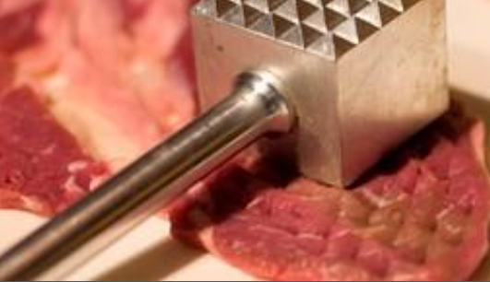
Which of the following is NOT a method used to tenderise meat?
A - Pounding
B - Marinating (vinegar or lemon/lime juice)
C - Slow cooking
D - Cooking quickly at a high temperature

Slide 26
Which of the following is NOT a method used to tenderise meat?
A - Pounding
B - Marinating (vinegar or lemon/lime juice)
C - Slow cooking
D - Cooking quickly at a high temperature

Slide 27
Success Criteria
I can
Describe the characteristics of red meat.
Identify different cuts of meat.
Describe food preparation techniques for meat.
Identify different cookery processes and when to use them.
Explain the benefits of supporting local producers.
Explain why reducing food waste and using leftovers is important.

