Slide 1
LESSON 3
Food Production, Packaging & Labelling

Slide 2
Learning Intentions
By the end of this presentation, we will learn about:
The different red meat products produced from pigs, cattle and sheep
How red meat can be traced from farm to consumer
How the red meat industry contributes to food security
How red meat is kept safe throughout the food chain
How red meat is processed, packaged and labelled

Slide 3
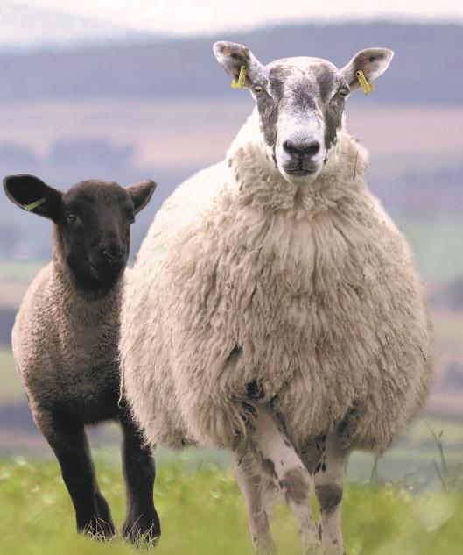
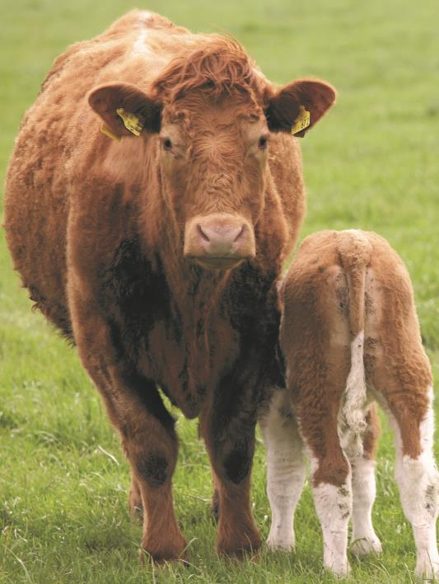
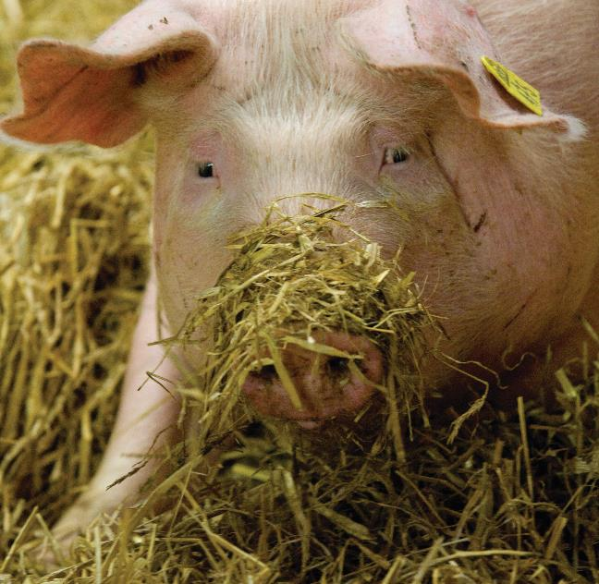
Red Meat Products
Bones – gelatine, collagen, bone meal
Wool & hair – clothing, carpets (useful properties including natural resistance to flame!) insulation
Hides & skins – leather
Fat – tallow, soap, candles
Horns & hooves – fertiliser
Organs & offal – food, pet food
Blood – fertiliser, animal feed
Other parts – pet food, cosmetics, industrial products
Sheep provide meat called either lamb (younger sheep) or mutton (older sheep).
Cattle provide beef
The main product that comes from pigs is pork.
Many other parts of the animal can also be used.
Using different parts of an animal can help make better use of the whole carcase and reduce waste.
Think, Pair, Share
How many different uses for cattle, sheep or pigs can you think of besides meat?

Slide 4
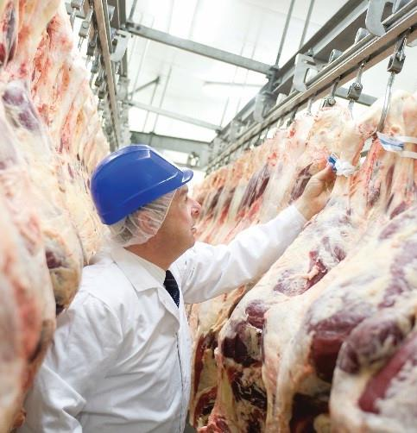
Abattoirs – Safe & Humane
Cattle, sheep and pigs are slaughtered in approved abattoirs, where food safety, hygiene and animal welfare requirements must be followed.
Animals are inspected before slaughter and carcases are inspected afterwards.
Trained staff handle and stun animals using approved methods.
CCTV is required in Scottish slaughterhouses where live animals are present.
After slaughter, carcases are processed into meat cuts and other products, including offal.

Slide 5
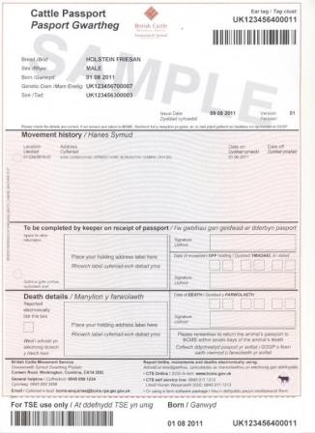
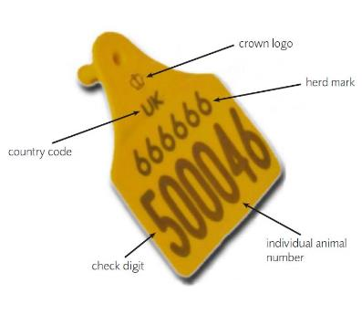
What does traceability mean?
Traceability is the ability to trace the origin of food and the journey food has made.
Cattle passport
Cattle tag
Why do you think it’s important?
In red meat production, traceability (from farm to fork) is important when considering the safe production of our food.
If there is a problem with any of the meat produced, the source can be easily traced and the issue resolved.
All cattle, sheep and pigs in the UK must have ear tags. Cattle also have passports to monitor their movements.

Slide 6
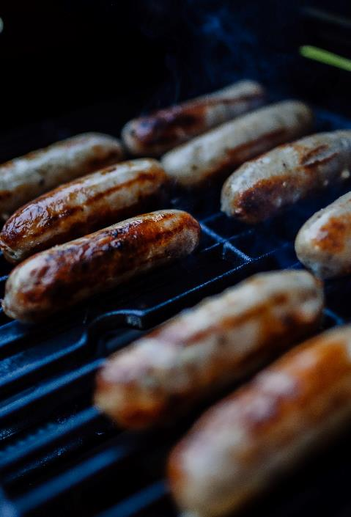
Food Processing
Foods are processed for several reasons:
to extend the shelf life, e.g. ham and bacon (this is why they are classed as processed meat because they have been processed to change their properties.)
convenience, e.g. ready-made lamb curry
health, e.g. reduced fat mince
to provide more variety and choice, e.g. pork and apple sausages
to provide additional nutritional benefits, e.g. fortified breakfast cereals
making food safe to eat by killing harmful bacteria, e.g. blast freezing
making foods become available that are out of season, e.g. freezing
making foods easier to prepare, this is important for people who live busy lifestyles and disabilities
Processing can be as simple as freezing food, but it can also be complex, e.g. formulating a frozen meal with the right balance of nutrients and ingredients.

Slide 7
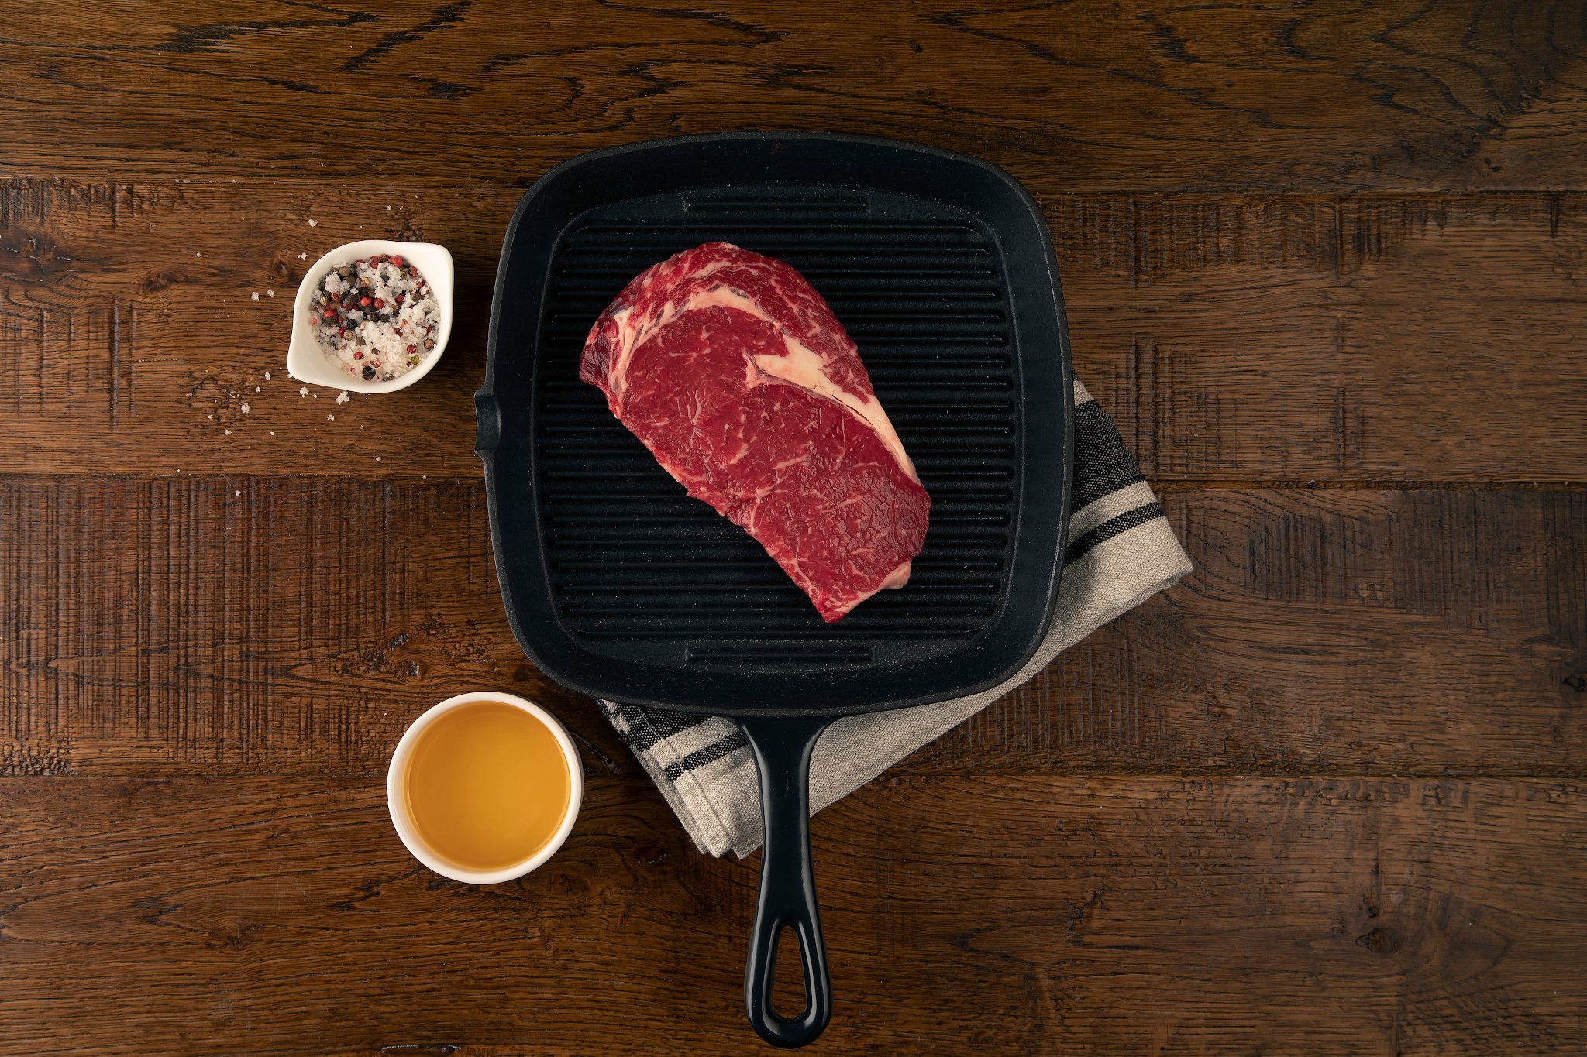
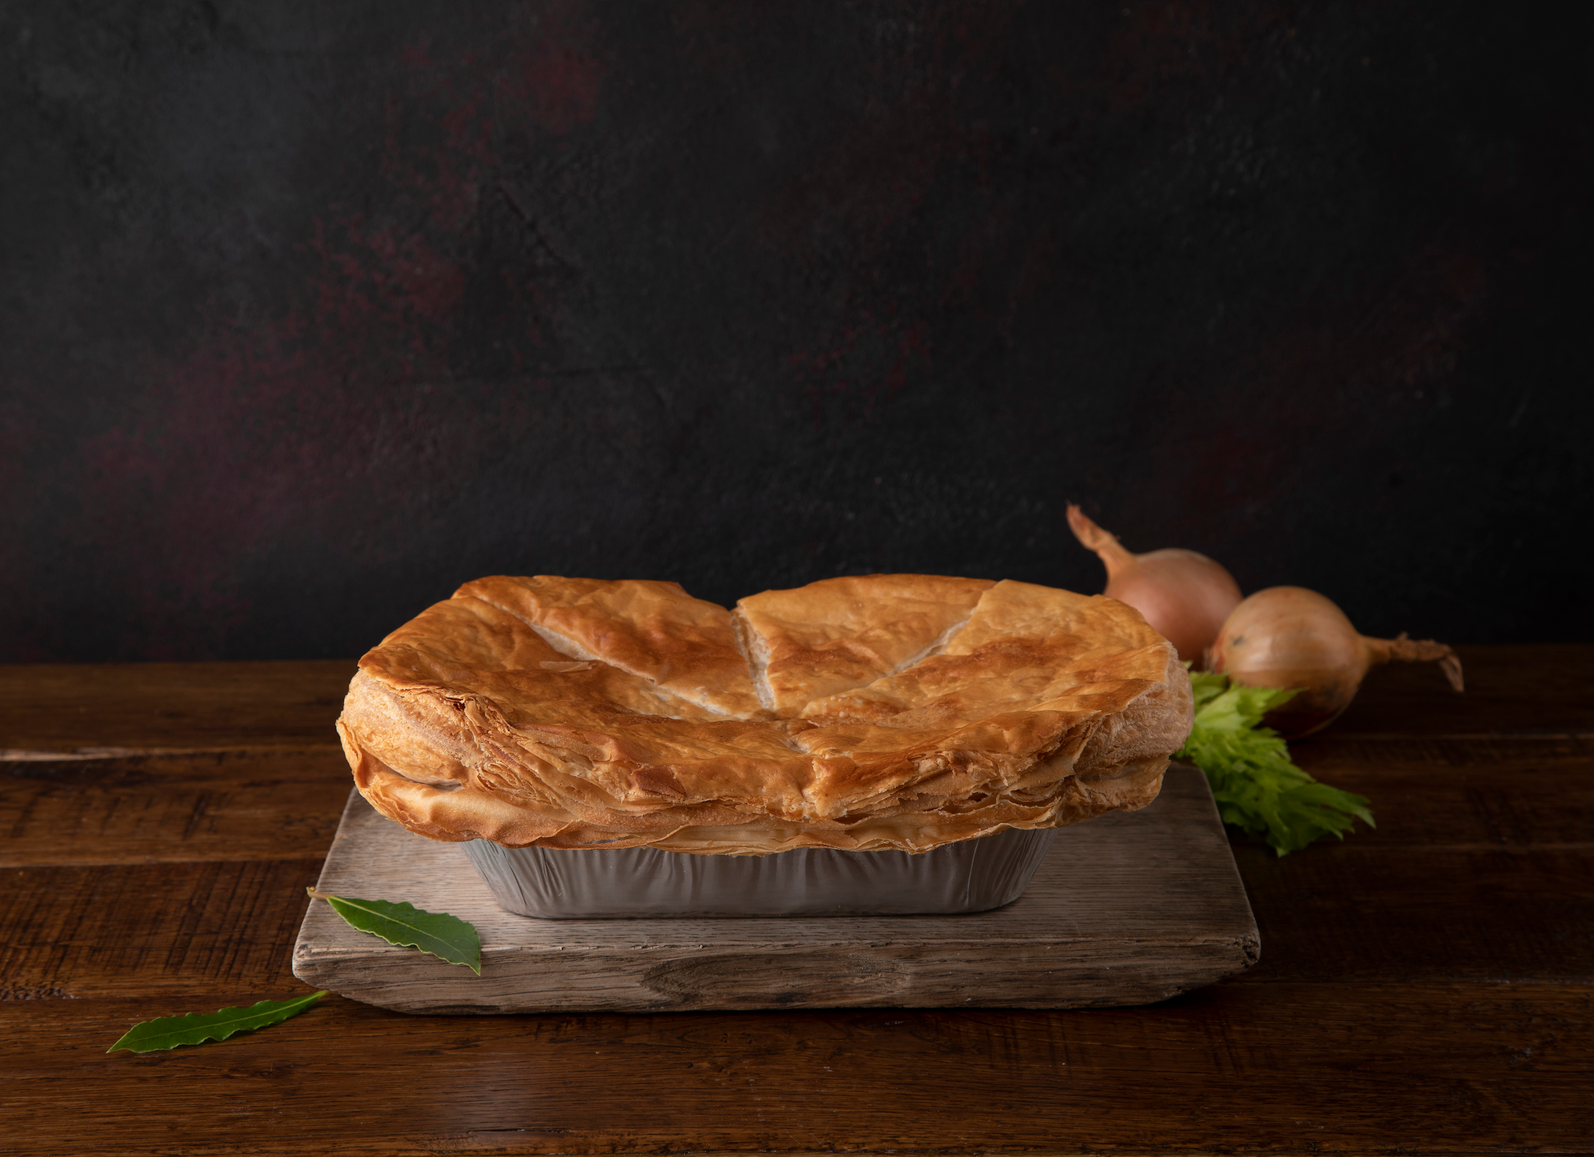
Types of Food Processing
Primary Food Processing:
Secondary Food Processing:
Foods are processed after harvest or slaughter.
Example: cattle carcass is butchered to produce sirloin steaks.
Food is made into edible products.
Example: beef is diced and is combined with other ingredients to be sold as a steak pie.

Slide 8
Red Meat Food Security
Food security means having reliable access to enough safe, nutritious and affordable food.
Food security can be affected by many factors, including:
Crop disease Human pandemic Soil erosion | Population growth Climate change International trade

Slide 9
Food Safety - Farm to Fork
Home
Consumers also have a role to:
Prevent cross-contamination
Store meat correctly
Follow use-by dates
Cook safely
Where should raw meat be stored in the fridge? Is this the same for cooked meat, such as sliced ham?
Food safety means handling, preparing and storing food to reduce the risk of foodborne illness. Food can become unsafe through bacteria, viruses, parasites or chemicals. Food safety is important at every stage:
Farm - Animal health, welfare and medicines are managed.
Feed - Animal feed is monitored for safety.
Abattoir - Animals and carcases are inspected. Hygiene procedures are followed.
Processors & Butchers - Food safety and hygiene requirements must be followed

Slide 10
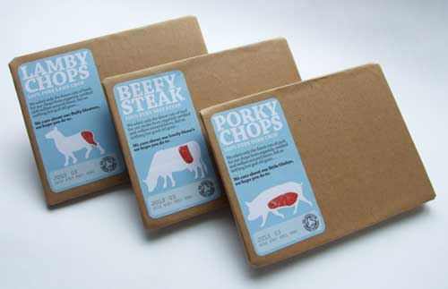
Packaging - what’s its purpose?
Protect meat from damage and contamination
Keep it fresh and extend shelf life
Help maintain food safety and quality
Make meat easier to store and transport
Provide a surface for labelling and traceability information
The majority of red meat products are sold in plastic packaging. However, research is underway to develop alternative packaging materials, with a focus on safety and how packaging degrades in the environment.
Pros of plastic | Cons of plastic
Creates a barrier to protect the meat. Can extend the shelf life and reduce food waste. Lightweight and easy to store and transport. | Environmental impacts. Waste can enter the environment if not managed properly Some meat packaging is difficult or impossible to recycle.

Slide 11
Food Labelling - Mandatory or Voluntary?
Food labels provide information to help consumers make informed choices.
Some information is required by law. This is called mandatory information.
What information can you find on a meat label?
Name of the food
Use-by date
List of ingredients & allergens
Net quantity (weight)
Nutrition information
Storage & cooking instructions
Country of origin, where required
Business name and address
Lot number

Slide 12
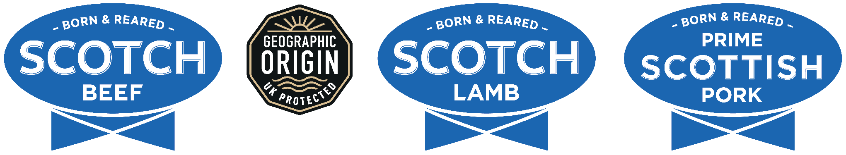
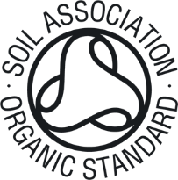

Voluntary - Logos
Some logos on food labels provide additional information about a product. There are several logos that can be found on red meat products. By finding out what the logos mean consumers can quickly get useful information about the product which may affect their buying decision.
Comes from animals born, reared and processed in Scotland. Covered by QMS whole-chain assurance. UK GI protects the name and origin of the product.
Shows the product meets organic production standards. Organic food must be certified by an approved control body.

Slide 13
When buying red meat, you might consider:
Price
Quality & freshness
Health & diet
Origin
Food safety
Environmental impact
Packaging
Labels & logos
List some factors that may influence your food choice when buying red meat.

Slide 14
Test your knowledge quiz
It’s time to put learning to the test with our simple quiz.
It will cover the content of this lesson, the main learning takeaways and provide opportunities for class discussion.

Slide 15
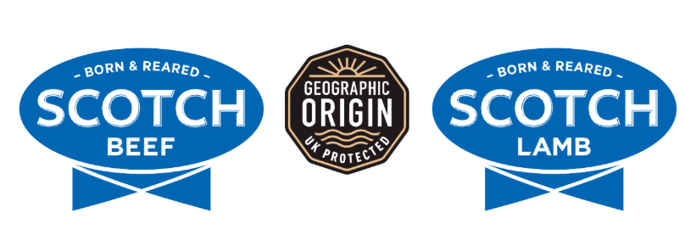
What do these logos mean?
A - The food is organic
B - The meat has been sustainably born, reared and processed in Scotland
C - The meat has been sustainably born, reared and processed in England
D - The food is certified gluten free

Slide 16
What do these logos mean?
A - The food is organic
B - The meat has been sustainably born, reared and processed in Scotland
C - The meat has been sustainably born, reared and processed in England
D - The food is certified gluten free

Slide 17
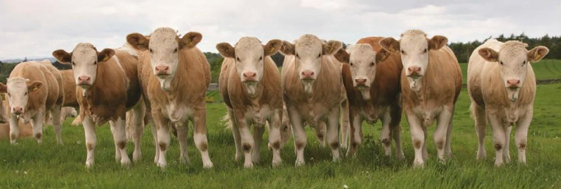
2. Traceability is the ability to trace the journey food has made and its source. Why is it important? (tick all that apply)
A - It ensures the safe production of food
B - Meat can be traced back to source ensuring it’s a genuine product
C - It allows farmers to take their livestock with them on holiday
D - If there is a problem with a product the source of the problem can be quickly traced

Slide 18
2. Traceability is the ability to trace the journey food has made and its source. Why is it important? (tick all that apply)
A - It ensures the safe production of food
B - Meat can be traced back to source ensuring it’s a genuine product
C - It allows farmers to take their livestock with them on holiday
D - If there is a problem with a product the source of the problem can be quickly traced

Slide 19
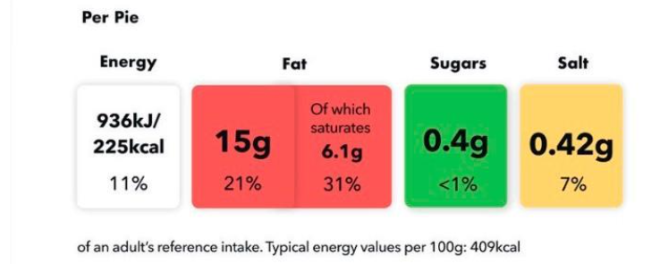
3. By law, which of the following details must be included on a food label? (Select the 4 correct answers)
A - The name of the food
B - The best before date or use by date
C - traffic light nutrition information
D - Ingredients list
E - farmers name
F - Allergens

Slide 20
3. By law, which of the following details must be included on a food label? (Select the 4 correct answers)
A - The name of the food
B - The best before date or use by date
C - traffic light nutrition information
D - Ingredients list
E - farmers name
F - Allergens

Slide 21
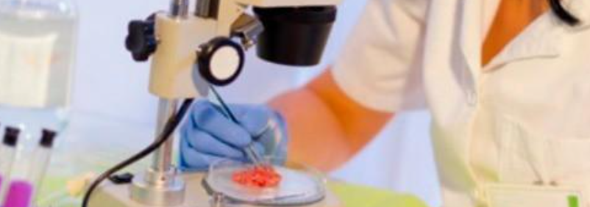
4. Why are meat products processed? (tick all that apply)
A - To extend the shelf life
B - To increase variety and improve convenience to the consumer
C - To improve the health of the product such as reducing fat
D - To provide additional nutritional benefits

Slide 22
4. Why are meat products processed? (tick all that apply)
A - To extend the shelf life
B - To increase variety and improve convenience to the consumer
C - To improve the health of the product such as reducing fat
D - To provide additional nutritional benefits

Slide 23
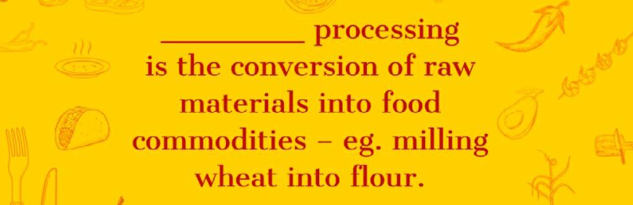
5. Which stage of food processing does the statement describe?
A - Primary Processing
B - Secondary Processing

Slide 24
5. Which stage of food processing does the statement describe?
A - Primary Processing
B - Secondary Processing

Slide 25
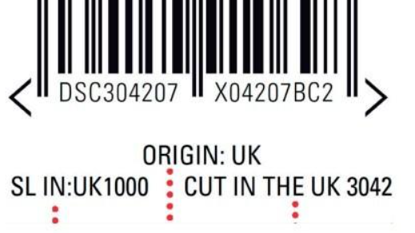
6. Why should consumers consider the country of origin that meat is produced in? (select all that apply)
A - Not all countries have animal welfare standards that are as high as the UK
B - They shouldn’t worry about it – all meat is produced equally
C - The sustainability credentials are not always the same (Scotland’s climate & landscape allows it to grow livestock naturally – this is not the same globally)
D - Traceability & farm assurance standards in the UK are some of the best in the world, not all other countries rate so highly.

Slide 26
6. Why should consumers consider the country of origin that meat is produced in? (select all that apply)
A - Not all countries have animal welfare standards that are as high as the UK
B - They shouldn’t worry about it – all meat is produced equally
C - The sustainability credentials are not always the same (Scotland’s climate & landscape allows it to grow livestock naturally – this is not the same globally)
D - Traceability & farm assurance standards in the UK are some of the best in the world, not all other countries rate so highly.

Slide 27
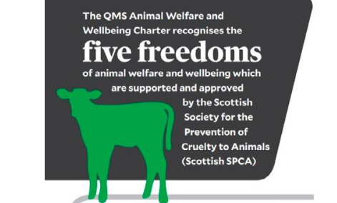
7. Animals go to abattoirs to ensure humane slaughter is carried out. There is always a vet present to ensure the highest welfare of the animals and that no injured sick animals enter the food chain.
A - True
B - False

Slide 28
7. Animals go to abattoirs to ensure humane slaughter is carried out. There is always a vet present to ensure the highest welfare of the animals and that no injured sick animals enter the food chain.
A - True
B - False

Slide 29
Key Points
Red meat products – cattle, sheep and pigs provide a range of meat and other products.
Traceability – red meat can be tracked through the food chain from farm to consumer.
Food processing – meat can be processed into different cuts and products.
Food security & safety – red meat is part of the wider food system and food safety is important at every stage.
Packaging & labelling – these help protect food and provide information to consumers.

Slide 30
Success Criteria
I can identify different products made from beef, lamb and pork.
I can explain what traceability means and why it is important.
I can describe some ways red meat safety is maintained from farm to consumer.
I can explain how packaging and labelling provide information to consumers.
I can identify different types of food processing used for red meat.

