Slide 1
LESSON 2
Sustainability and the Environment

Slide 2
Learning Intentions
By the end of this presentation, we will:
Understand what sustainable food means.
Learn about greenhouse gases (GHGs), including carbon dioxide, methane and nitrous oxide.
Explore how STEM can support sustainability.
Learn about steps Scottish farmers are taking to improve sustainability.
Understand the importance of biodiversity.
Compare Scottish and global red meat production.
Explore economic and social sustainability.
Understand how individuals can make a difference.

Slide 3
What is sustainable food?
There is no single legal definition of sustainable food. Sustain, an organisation that works for better food
and farming, has developed a working definition.
Sustainable food should be produced, processed, transported and used in ways that:
Support people and local economies – provide jobs and fair livelihoods.
Protect animals and biodiversity – look after farmed animals, wildlife and plant life.
Protect the environment – reduce waste, protect natural resources and help tackle climate change.
Benefit society – provide good-quality, safe and healthy food, and opportunities to learn.
Source: Sustain – the alliance for better food and farming.

Slide 4
What does this mean in practice?
Sustainable food considers three main areas:
Environmental – protecting nature, soil and water, and reducing waste and greenhouse gas emissions.
Economic – supporting farmers, food producers, jobs and local businesses.
Social – considering food quality, safety, animal welfare and the wellbeing of people.
How could a farm produce food while considering all three areas?

Slide 5
Greenhouse Gases (GHG) From Farming
In livestock farming, the three gases that are emitted into the atmosphere by farming activities are:
Carbon Dioxide CO² from burning fossil fuels – ie. Driving tractors.
Methane CH⁴ from cow and sheep burps.
Nitrous Oxide N²0 which occurs naturally from the soil.
Each of these gases is different and farmers are working to reduce their outputs to reduce their impact on the environment.

Slide 6
Greenhouse Gas (GHG) Summary
The table below highlights the different types of GHG released due to livestock farming activity.
Type | Source | Amount of farm’s emissions | Lifetime in Atmosphere | Carbon Dioxide Equivalent
Carbon Dioxide (CO2) | Burning fossil fuels | 2% to 10%, depending on farm type and activities | around 65-80% of CO2 emissions are around for 20 to 200 years (remainder >1000s years) | 1
Methane (CH4) | Natural bi-product of livestock (cows/sheep’s burbs) | around 40%, depending on farm type. | lasts approximately 12 years in atmosphere. | 21 times more potent than CO2.
Nitrous Oxide (N2O) | Naturally occurring from soils – increased by cultivation and fertiliser application. | around 50%+, depending on farm activities. | lasts approximately 115 years in atmosphere. | 310 times more potent than CO2.
DISCUSSION POINT: Looking at the table above, which of the gases do you think is most harmful to the environment?

Slide 7
STEM for Sustainability
Farming is changing rapidly and advances in Science, Technology, Engineering and Maths (STEM subjects) are helping farmers to become more efficient and lower their impact on the environment.
Below are some examples of scientific, engineering and technological solutions farmers are using to reduce their farm’s carbon footprint. More information on some of these can be found at: https://www.nesta.org.uk/feature/precision-agriculture/
Genetics Mapping Fields Soil Scanning Thermal Imaging | Drones Smart Tractors – GPS Texting Cows Electronic Identification | Grass Measuring Technology Automatic Weighing Agribots Precision Farming
The next slide shows a short video highlighting one example of how science and technology are playing an important role in the research of red meat sustainability.

Slide 8
What farmers are doing…
Steps farmers are taking to be more sustainable include:
Taking action to control soil erosion.
Protecting peatland and moorland from damage by avoiding ploughing, drainage and over grazing.
Considering reduced cultivation to protect farm soils and reduce carbon losses.
Managing existing farm woodlands and considering new planting.
Creating wildlife corridors along water margins, field margins and headlands.
Protecting and where necessary restoring wetlands including floodplain management.
Planting trees and wildflowers.
Ensuring farms are run efficiently
However, not all farmers are keen to make these changes.
The Scottish Government, who provide financial support to farmers, are now using financial incentives to encourage reluctant farmers to take positive steps to help improve their sustainability.

Slide 9
Biodiversity
Biodiversity is the existence of a wide variety of plant and animal species living in their natural environment and is the basis of agriculture.
Factors that need to be considered when thinking about biodiversity in livestock farming are the impact agriculture has on:
Insect pollinators Insects Farmland birds | Waders Soil Biodiversity Wild animals | Plants Woodland Water biodiversity
However, farmers need to balance this with the impact some of these measures can have on productivity, other land users and animal welfare.
Farming practices can have a positive or negative impact on biodiversity. Sometimes a practice can be positive for one species, but negative for another.
Farming practices that are undertaken to encourage biodiversity include:– water margins, field margins, planning and maintaining trees & hedges and protecting known habitats.

Slide 10
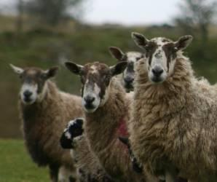
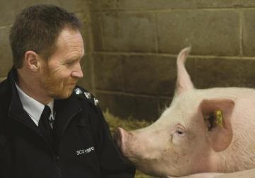
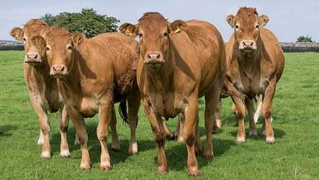
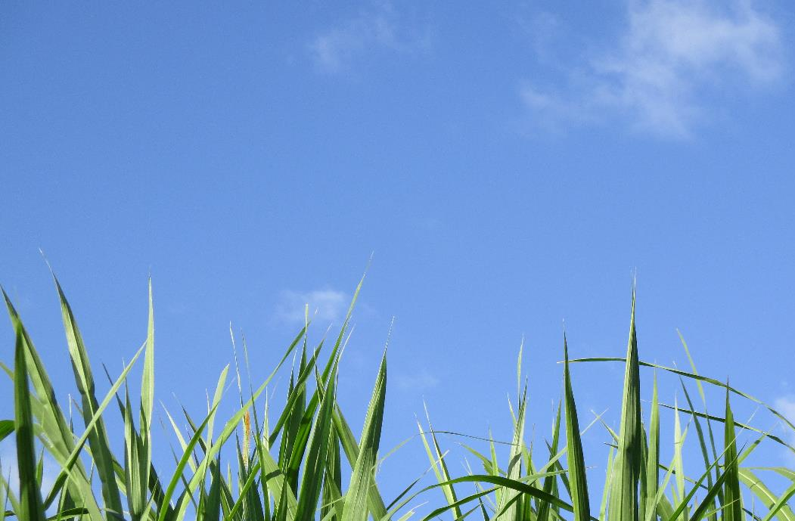
Scotland v. Global Meat Production: Scotland (and rest of UK)
Scotland (and the rest of the UK’s) red meat production:
Has lower food miles
Is a natural system - most cattle graze outside on grass during the summer months and are housed in cattle sheds for the winter. Although some do graze on grass and silage outside year round.
Is suited to Scotland’s climate and landscape.
Has a world-class whole of life and whole of supply chain Quality Assurance Scheme –including high standards of Animal Welfare.
The Scottish SSPCA endorses the Scotch Beef, Scotch Lamb & Prime Scottish Pork brands
Has high food safety standards – food is safe due to strict rules about traceability.
Doesn’t damage rainforests or areas of natural heritage.

Slide 11
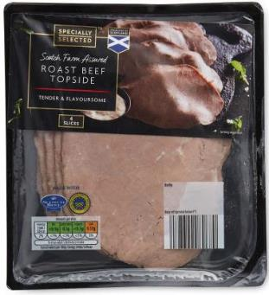
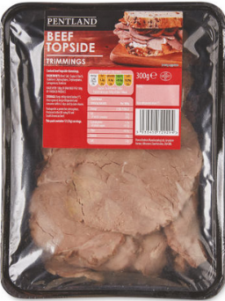
Think, Pair, Share... Looking at the table, which of the products do you think is most harmful to the environment?
 | Option 1: Scotch Beef Sliced Beef Slices | Option 2: Sliced Beef Slices
Country of origin | Scotland | South America
Price | £1.79 (£1.79 per 100g) | £1.89 (63p per 100g)
Amount | 100g | 300g

Slide 12
Economic & Social Sustainability
As we have learnt from Sustain’s definition, sustainability is about more than just environmental sustainability.
Economic & social sustainability are also important.
The red meat Industry:
supports around 40,000 jobs, many of these are in remote, fragile areas.
contributes over £4.2 billion to the Scottish economy annually.
boosts tourism and recreation.
protects family farming which is a way of life for many rural families.

Slide 13


What can you do?
Reduce food waste & food miles by eating locally produced food.
Think about packaging – it’s creation also emits carbon.
Find out where your food comes from and how it is produced.
Eat foods when they are in season.
Investigate if there are other ways you can reduce your own carbon footprint - food is just one factor.
Find out what the labels mean and use them to inform your decisions.

Slide 14
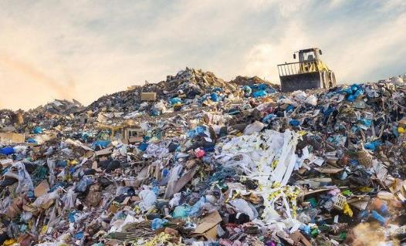
Food Waste
The 2025 WRAP report estimates that around 10.2 million tonnes of food waste are produced in the UK each year.
When food breaks down in landfill, it can release methane, a powerful greenhouse gas.
Putting food waste in a separate food waste bin allows it to be treated in a different way.
At an anaerobic digestion facility, microorganisms break down food waste and produce biogas, which can be used to generate electricity and heat.
Think, Pair, Share... how can we reduce food waste?

Slide 15
Scottish Red Meat Industry - Sustainability Summary
Scottish red meat production can contribute to:
Local economies and livelihoods through jobs and support for rural communities.
Nature and animal welfare by protecting biodiversity and caring for farmed animals.
Responsible resource use by reducing waste and environmental impacts.
Good-quality food that provides social benefits.
There is still more to do. Farmers and the wider food industry need to keep improving sustainability.
Scotland’s target: The Scottish Government has a legally binding target to achieve net zero greenhouse gas emissions by 2045.

Slide 16
Key Points – Sustainable Food
Sustainability is complex – food production has environmental, economic and social impacts.
Greenhouse gases – livestock farming produces carbon dioxide, methane and nitrous oxide.
Biodiversity – farming can help or harm wildlife, pollinators, birds, plants and soil life.
Economic and social benefits – Scotland’s red meat sector supports around 40,000 jobs and rural communities.
Science and technology – new methods can help farmers improve efficiency and reduce emissions.
Scottish red meat production – Scotland’s climate and grassland suit livestock farming, while quality assurance schemes support standards across the food chain.
Individual choices matter – reduce food waste, consider food miles, recycle where possible, choose seasonal food and find out where food comes from.

Slide 17
Success Criteria
I can
Define sustainable food.
Identify the three main greenhouse gases associated with livestock farming.
Describe how farming can affect biodiversity.
Explain how STEM can help farmers improve sustainability.
Compare Scottish and global red meat production.
Describe the economic and social benefits of the Scottish red meat industry.
Identify ways I can make more sustainable food choices.

