Slide 1
LESSON 1
Introduction to the red meat industry and livestock farming techniques.

Slide 2
Learning Intentions
By the end of this presentation, we will:
Understand what red meat is.
Identify different types of farms in Scotland.
Understand what Scottish farms produce.
Learn about cattle breeds and how cattle are managed.
Learn about sheep breeds and how sheep are managed.
Learn about pig breeds and how pigs are managed.
Understand animal welfare.
Understand quality assurance and why it is important.

Slide 3
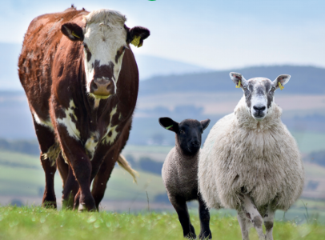
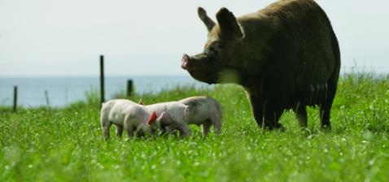
What is red meat?
Scotland produces red meat from cattle, sheep, pigs, goats and deer.
Cattle, sheep and pigs are the main animals.
Raw red meat is dark red because it contains myoglobin, a protein found in muscle.
Red Meat Food System
The red meat food system shows how meat gets from farm to plate.
Let's watch the Farming Circle of Life video.

Slide 4
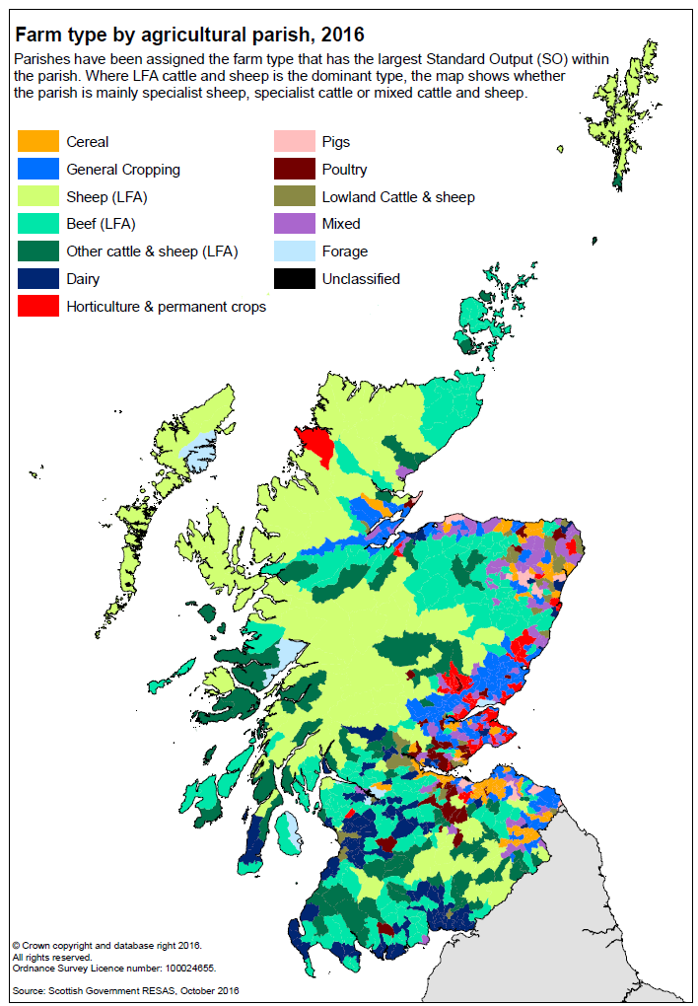
Farming in Scotland
82% is not suitable for growing crops, fruit or vegetables.
Much of this land is ideal for growing grass for cattle and sheep1.
The type of farming depends on the soil, landscape and climate.
Can you name some other types of farms?
​
Arable/cereal, dairy, potato, deer, poultry, sheep, beef, pig, fruit & vegetable, horticulture, crofting, small holdings.
How many did you get?
1: Results from the Scottish Agricultural Census: June 2025 - gov.scot

Slide 5
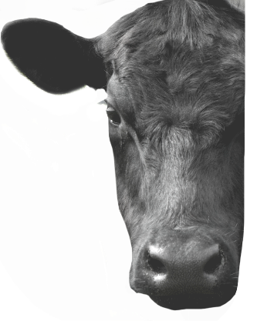
Cattle
Scotland has 1.64 million cattle (2025)1.​
80% are kept to produce meat and the rest are dairy cattle that produce milk.
Cows – females that have had a calf.
Calves – young cattle.
Bulls – male breeding cattle.
Heifers – young females that have not had a calf.
Steers/bullocks/stots – young males not kept for breeding.
Cattle have ear tags and passports to identify and track them.
Most cattle are outside in summer and inside in winter.
Some cattle stay outside all year round.
1: Results from the Scottish Agricultural Census: June 2025 - gov.scot

Slide 6
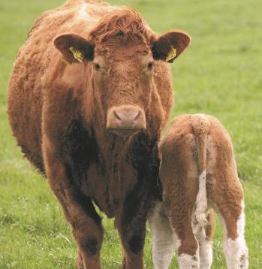
Cattle Facts - Did you know?
Cows are pregnant for about nine months.
Calves can stand within minutes of being born.
Cows usually have one calf but can sometimes have twins. Occasionally triplets!
Calves stay with their mothers for 6‒9 months before being weaned.
Weaning is when they no longer require milk from their mother and the majority of their diet is grass.
A weaned calf weighs around 200‒350 kg.
Cattle are ready to be sold for meat once they are adults - they can weigh up to 700 kg.

Slide 7
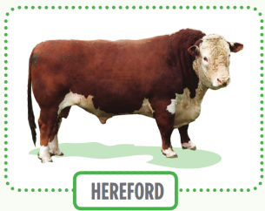
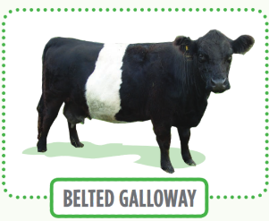
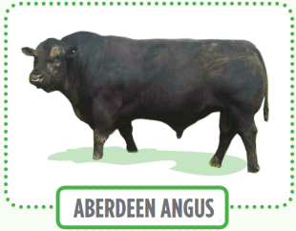
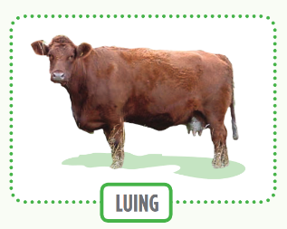
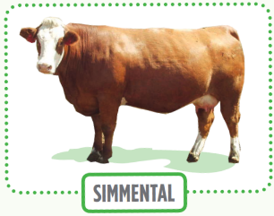
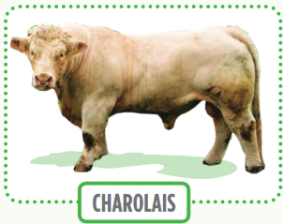
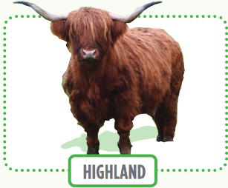
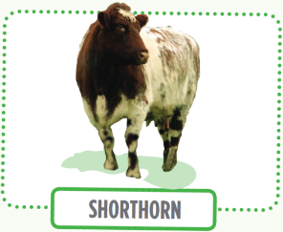
Cattle Breeds
Farmers choose breeds based on the type of farm they have.
Different breeds can also be crossed to get the best features from each.
There are over 200 breeds of cattle in the UK. Can you name any?

Slide 8
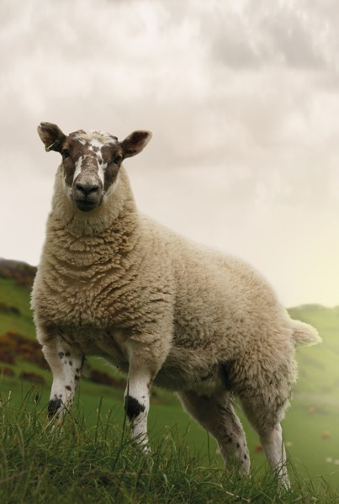
Sheep Facts
Ewes – female sheep that have had a lamb
Gimmers – female sheep that haven’t had a lamb
Lambs – the young sheep
Rams/Tups – the male breeding sheep.
Most sheep live outside all year round.
Lambs are usually born in the Spring.
Sheep are pregnant for about 5 months.
Many are scanned before lambing to find out how many lambs they are going to have.
Most sheep have twins, but they can have singles, triplets or quads.
Lambs stay with their mothers for 3–5 months.
Lambs are sold for meat when they reach around 38–40 kg.
Scotland has 6.54 million sheep (2025)1.​
1: Results from the Scottish Agricultural Census: June 2025 - gov.scot

Slide 9
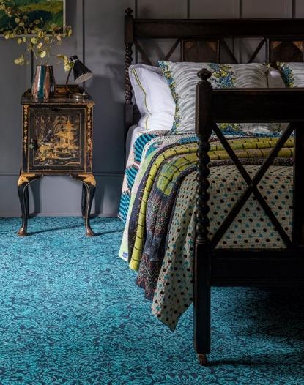
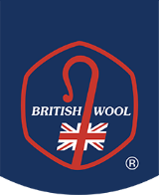
Wool
Sheep grow a wool fleece every year to protect them from the weather.
They are shorn (wool removed) in summer.
In Scotland, sheep are mainly kept for meat, not wool.
Wool is a natural and sustainable material. Can you think of any uses for wool?
Wool can be used for clothes, bedding, sofas, insulation, carpets, kilts, tweeds and much more.
Notes:
For more information visit: British Wool

Slide 10
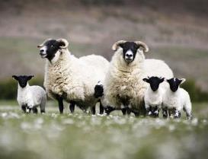
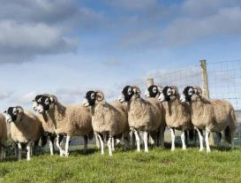
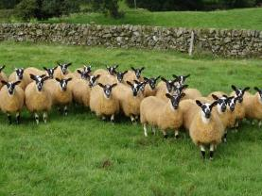
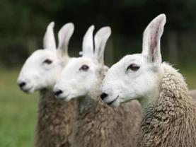
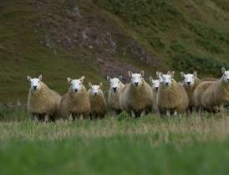
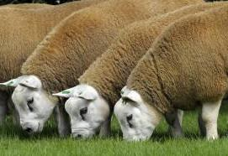
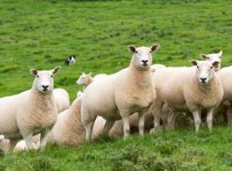
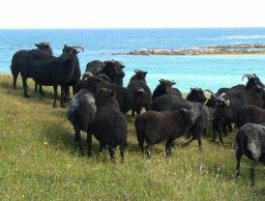
Sheep Breeds
There are over 90 breeds and crosses of sheep in the UK.
Farmers choose sheep breeds based on their farm type and what they want to produce.
Blackface Sheep
Swaledale Sheep
Scotch Mule Sheep
Border Leicester Sheep
Cheviot Sheep
Texel Sheep
Lleyn Sheep
Hebridean Sheep
The National Sheep Association have a list of UK sheep breeds on their website. Pictures courtesy of the National Sheep Association (NSA).

Slide 11
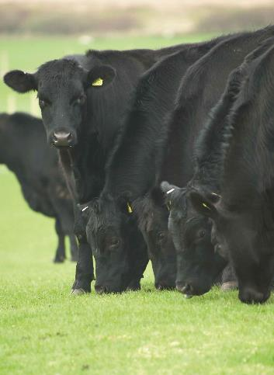
Cattle & Sheep Feeding
Cattle and sheep are ruminants - they have one stomach with four separate compartments.
This allows them to get the nutrients they need from grass.
Grass can be eaten straight from the fields or left to grow then cut (harvested) to be made into silage or hay to feed in the winter.
They also eat cereals like barley, wheat and oats, vegetables and potatoes.
Both sheep and cattle are also given minerals to supplement their diet.

Slide 12
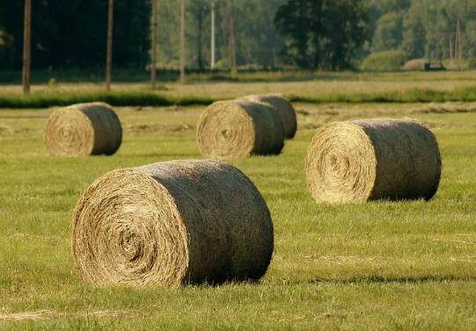
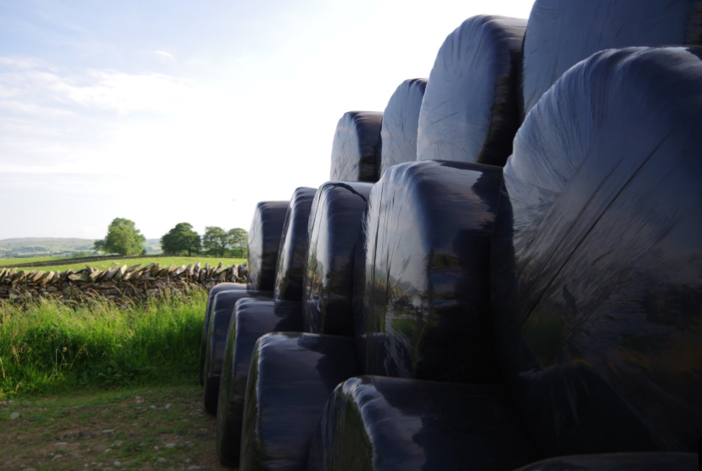
Silage v Hay
Silage is grass that has been ‘pickled’.
Grass is cut, dried slightly and packed tightly.
It is covered in plastic to keep out oxygen.
This causes fermentation, which helps keep the grass nutritious.
Silage is used to feed cattle and sheep in winter.
Hay is grass that is cut and dried in the sun, usually for about a week. It is then baled and stored under cover.

Slide 13
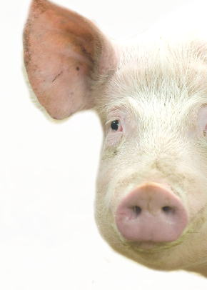
Pigs
Sows – female pigs that have had piglets.
Gilts – female pigs that have not had piglets.
Piglets – young pigs.
Boars – male breeding pigs.
Pig farming
Pigs are kept indoors or outdoors. If pigs are outdoors in the summer they use mud as sunscreen to protect their fair skin!
Pigs eat a balanced diet of cereals, soya, vitamins and minerals.
Some feed comes from by-products such as whey and waste oats.
Sows are pregnant for 3 months, 3 weeks and 3 days.
A sow can have 10–15 piglets per litter.
Piglets are weaned at around 4 weeks.
Pigs grow quickly, from 1–1.5 kg at birth to 110–130 kg when they are sold for meat.
Common breeds
Large White • Landrace • Duroc • Hampshire
(2025 Scottish Government Agricultural Census.)​
There are around​ 312,300 pigs in Scotland​.

Slide 14
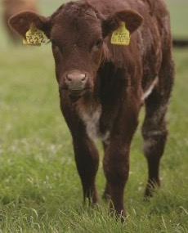
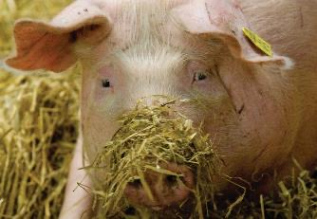
Traceability
Cattle, sheep and pigs get an ear tag when they are born.
Ear tags help farmers identify and track animals.
This helps with food safety and disease control.
Electronic tags can collect data to improve animal welfare.
Some pig farmers use tags to measure how much pigs eat.

Slide 15
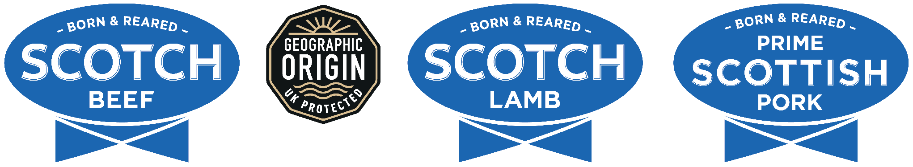
Quality Assurance
Many foods are part of an assurance scheme which reassures the consumer that their food is produced to a certain set of standards.
Around 8,093 farms and crofts in Scotland are part of the red meat quality assurance scheme delivered by Quality Meat Scotland (QMS).
Each farm is visited by an independent assessor every year.
The inspectors are looking for a list of standards to be met including:
  Good animal welfare (see next slide)
  Accurate record taking
  Safe working practices
  Correct application/storage of medicine
  Biosecurity & cleanliness - preventing disease from entering or spreading on the farm.
Only farmers who have met these standards are eligible to sell under the brands.

Slide 16
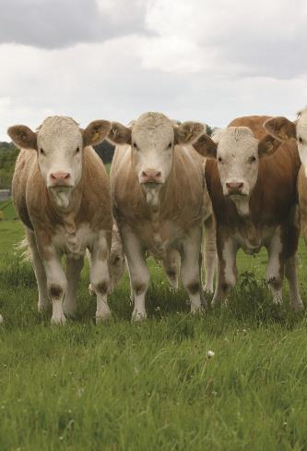

Animal Welfare in Scotland
This is a priority in Scottish livestock farming.
The Scottish SPCA supports the QMS Quality Assurance Scheme, which has been running for 35 years.
Farms are inspected every year to make sure high welfare standards are met.
Farmers spend lots of time with their animals, checking their health and wellbeing.
Vets and animal nutritionists work with farmers to help keep animals healthy.
List examples of good animal welfare?

Slide 17
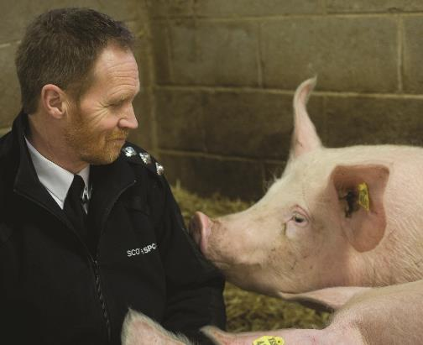
5 Welfare Freedoms
These are the very minimum principles on which Animal Welfare and Wellbeing should be based.
Animals should have:
Freedom from hunger and poor nutrition
Freedom from discomfort
Freedom from pain, injury and disease
Freedom to behave normally
Freedom from fear and distress

Slide 18
Test your knowledge
It’s time to put learning to the test with our simple quiz.
It will cover the content of this lesson, the main learning takeaways and provide opportunities for class discussion.
Notes:
This presentation has provided an overview to farming cattle, sheep and pigs in Scotland.
However, it is important to remember that farming practices vary across farms throughout Scotland.
To enhance your learning further, please return to the
Make it Scotch learning resource.

Slide 19
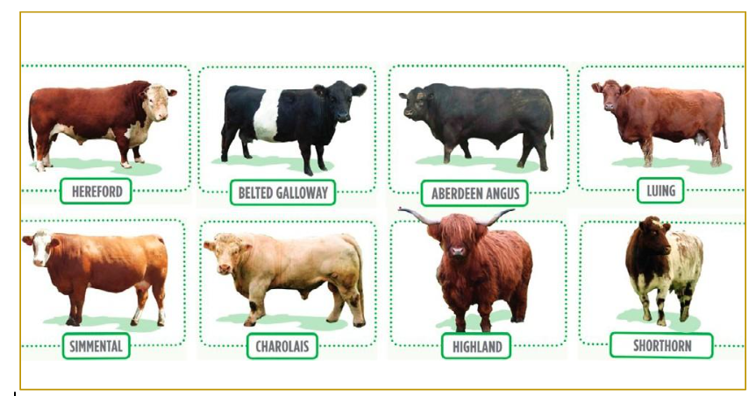
The breed of beef cattle a farmer has is determined by...
A - The type of farm they have
B - Their preference
C - The topography of their farm (is it hilly or flat)
D - All of the above

Slide 20
The breed of beef cattle a farmer has is determined by...
A - The type of farm they have
B - Their preference
C - The topography of their farm (is it hilly or flat)
D - All of the above

Slide 21
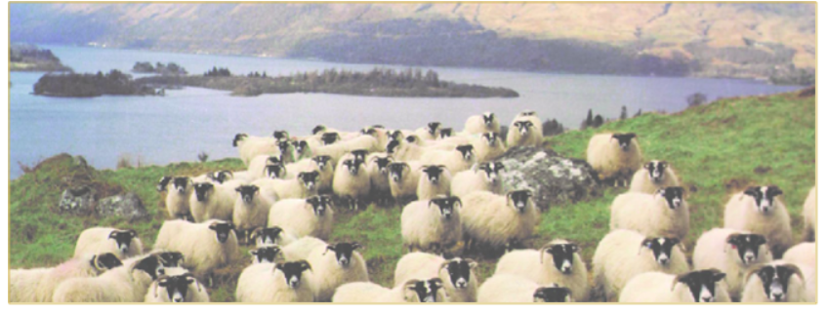
What breed of sheep is this?
A - Blackface sheep
B - Horned sheep
C - Whiteface sheep
D - Hebridean sheep

Slide 22
What breed of sheep is this?
A - Blackface sheep
B - Horned sheep
C - Whiteface sheep
D - Hebridean sheep

Slide 23
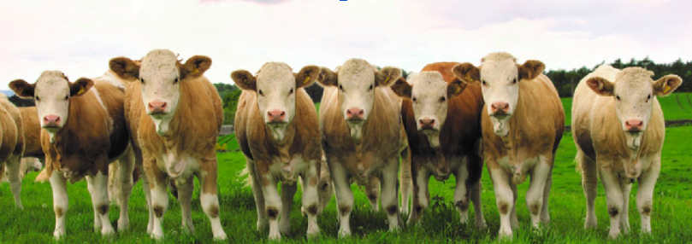
Cattle & sheep are ruminants which means they have how many stomach compartments?
A - 1
B - 2
C - 3
D - 4

Slide 24
Cattle & sheep are ruminants which means they have how many stomach compartments?
A - 1
B - 2
C - 3
D - 4

Slide 25
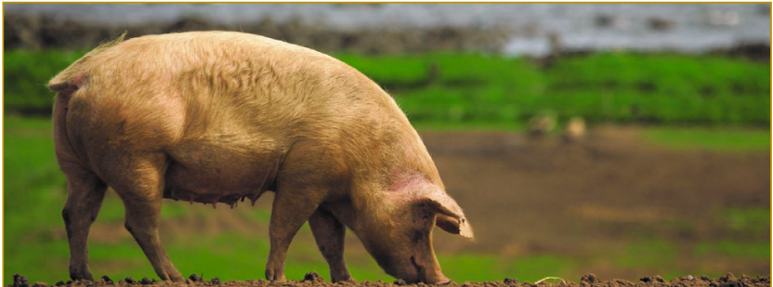
Female pigs are called...
A - Boars
B - Gilts
C - Sows
D - Piglets

Slide 26
Female pigs are called...
A - Boars
B - Gilts
C - Sows
D - Piglets

Slide 27
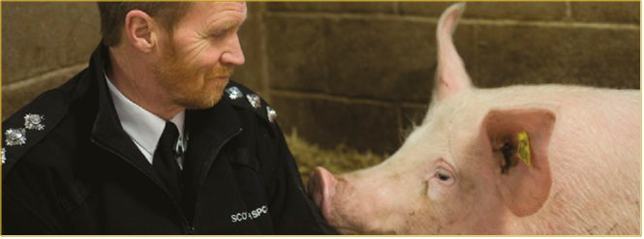
Which of the list below is NOT an animal welfare & wellbeing freedom:
A - Freedom from hunger and malnutrition
B - Freedom from music
C - Freedom from fear and distress
D - Freedom from discomfort
E - Freedom to express normal behaviours

Slide 28
Which of the list below is NOT an animal welfare & wellbeing freedom:
A - Freedom from hunger and malnutrition
B - Freedom from music
C - Freedom from fear and distress
D - Freedom from discomfort
E - Freedom to express normal behaviours

Slide 29
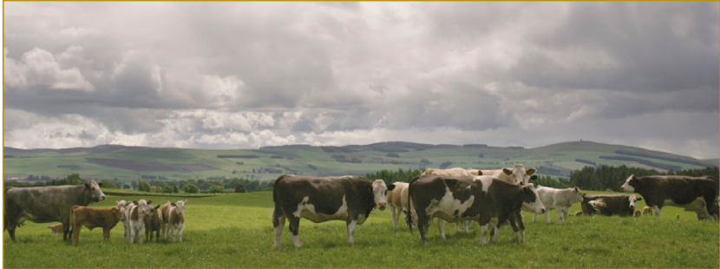
Animal welfare standards are the same across the world.
A - True
B - False

Slide 30
Animal welfare standards are the same across the world.
A - True
B - False

Slide 31
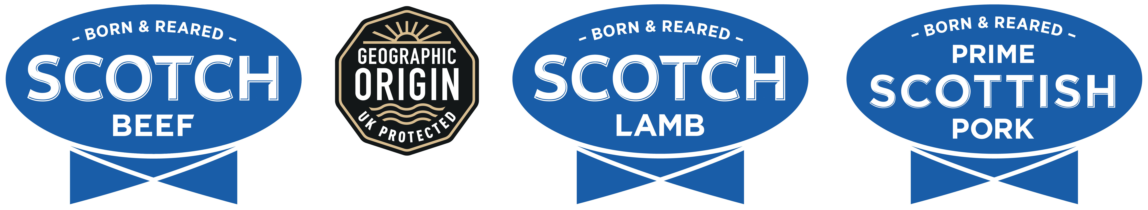
For meat to be sold using the logos above the animals must be part of the Quality Meat Assurance Scheme. What are the inspectors looking for when they inspect Assurance Scheme farms?
A - Good animal welfare
B - Safe working practices
C - Ensuring that the animals have been born and reared in Scotland
D - Accurate record taking
E - A tidy farm
F - All of the above

Slide 32
For meat to be sold using the logos above the animals must be part of the Quality Meat Assurance Scheme. What are the inspectors looking for when they inspect Assurance Scheme farms?
A - Good animal welfare
B - Safe working practices
C - Ensuring that the animals have been born and reared in Scotland
D - Accurate record taking
E - A tidy farm
F - All of the above

Slide 33
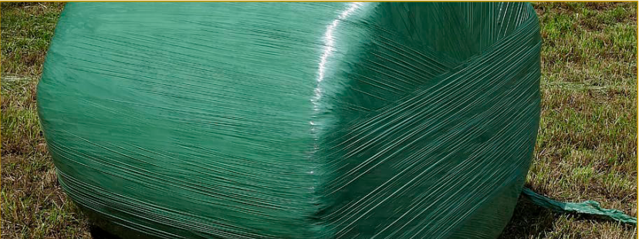
What type of animal food does this describe? "grass that has been cut then put into either a pit or bales and covered in plastic".
A - Straw
B - Silage
C - Hay

Slide 34
What type of animal food does this describe? "grass that has been cut then put into either a pit or bales and covered in plastic".
A - Straw
B - Silage
C - Hay

Slide 35
Task
Complete the worksheet to test your knowledge and understanding of the red meat industry and livestock farming techniques.
Notes:
This presentation has provided an overview to farming cattle, sheep and pigs in Scotland.
However, it is important to remember that farming practices vary across farms throughout Scotland.
To enhance your learning further, please return to the
Make it Scotch learning resource.

Slide 36
Key Points - Red Meat Farming in Scotland
Much of Scotland is not suitable for growing crops, but is ideal for growing grass.
Cattle and sheep can use this grass for food.
Cattle are usually outside in summer and housed in winter.
Most sheep are outside all year round.
Pigs can be kept indoors or outdoors.
Cattle and sheep are ruminants, with a four-part stomach that helps them digest grass.
Cattle, sheep and pigs have ear tags so they can be identified and tracked.
Traceability helps protect food safety and control disease.
Animal welfare is a priority, with the Five Freedoms as basic welfare principles.
Quality assurance checks that farms meet required standards

Slide 37
Success Criteria
I can
Describe what red meat is.
Identify different types of farms in Scotland.
Describe what Scottish farms produce.
Identify cattle breeds and how cattle are managed.
Identify sheep breeds and how sheep are managed.
Identify pig breeds and how pigs are managed.
Describe what animal welfare is.
Briefly describe quality assurance and why it is important.

